Slide 1
Tang Lab Rotation
Irenaeus Chan

Slide 2
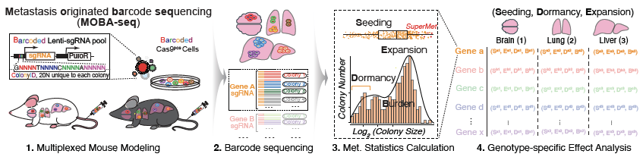
Metastasis Originating Barcode Sequencing

Slide 3
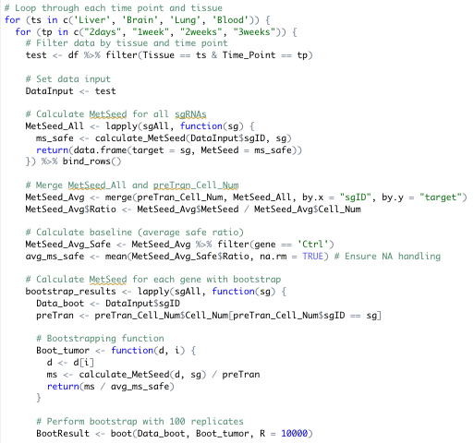
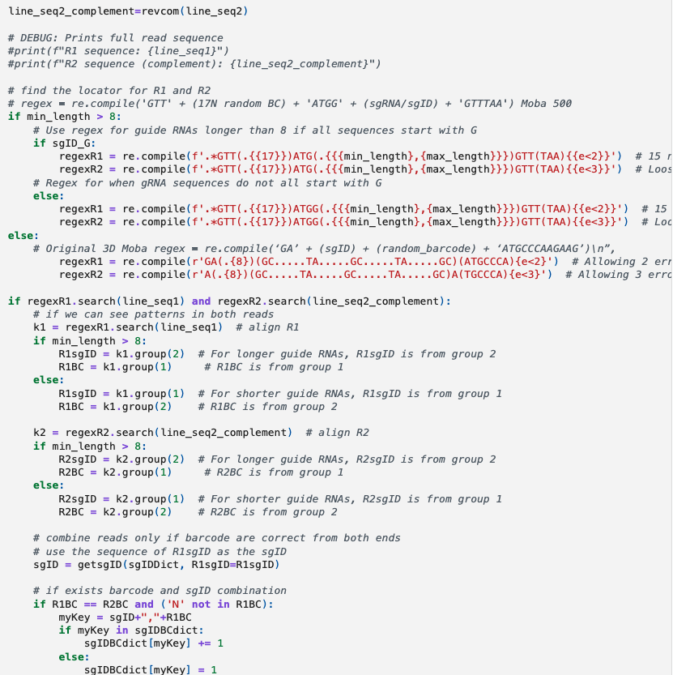
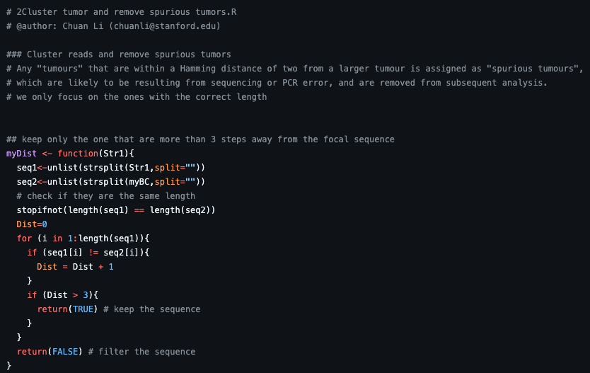



Metastasis Originating Barcode Sequencing

Slide 4
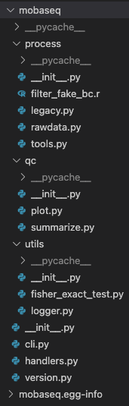
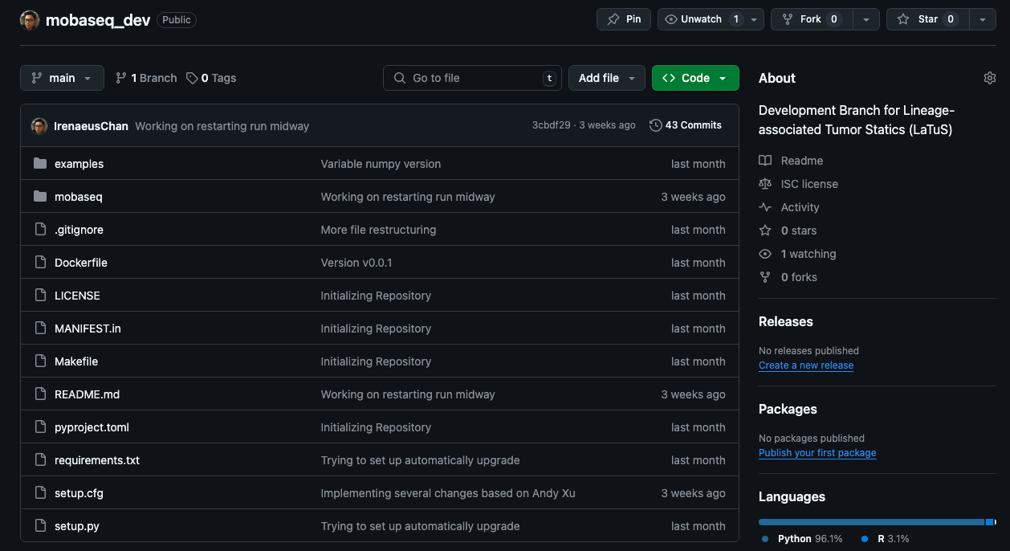

Slide 5
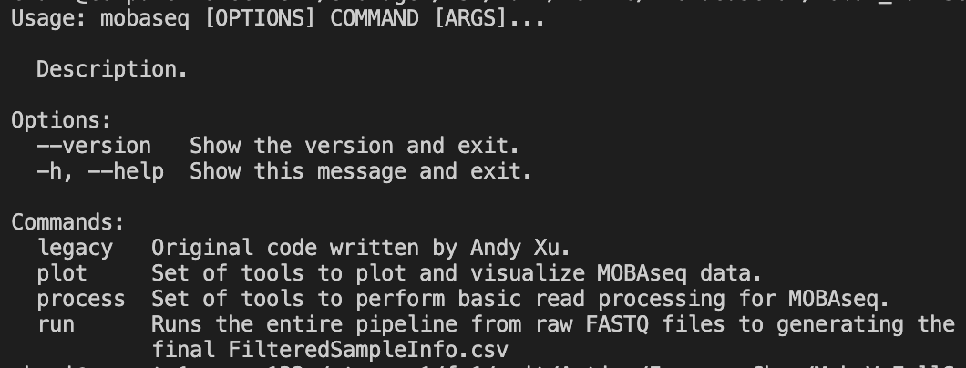
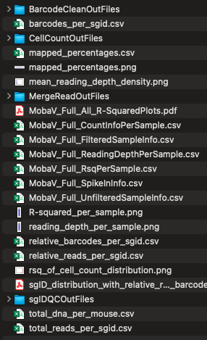
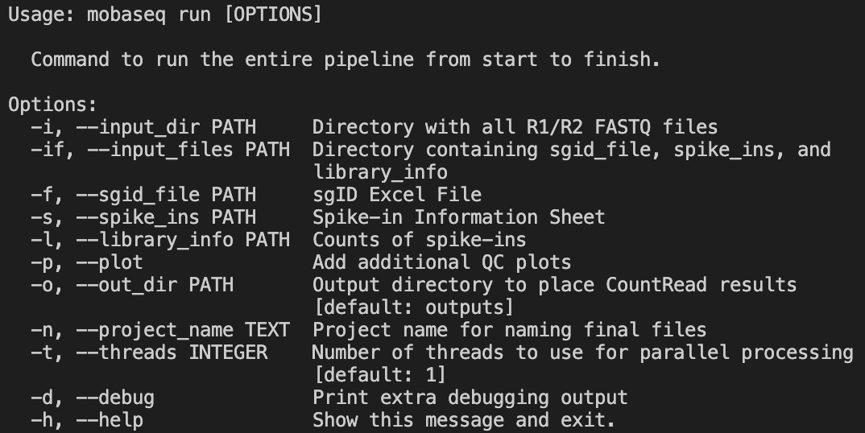

Slide 6
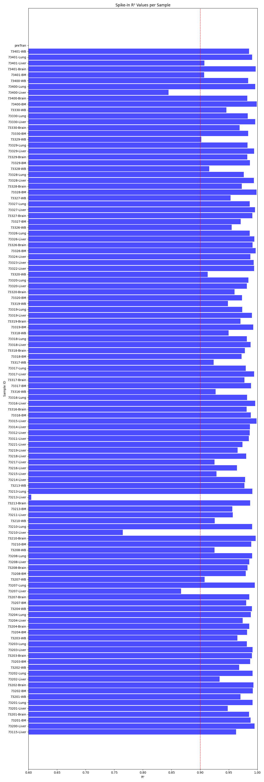
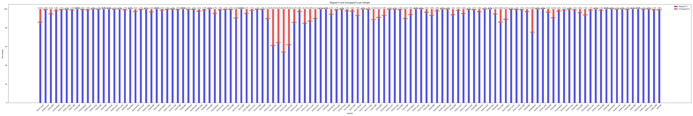
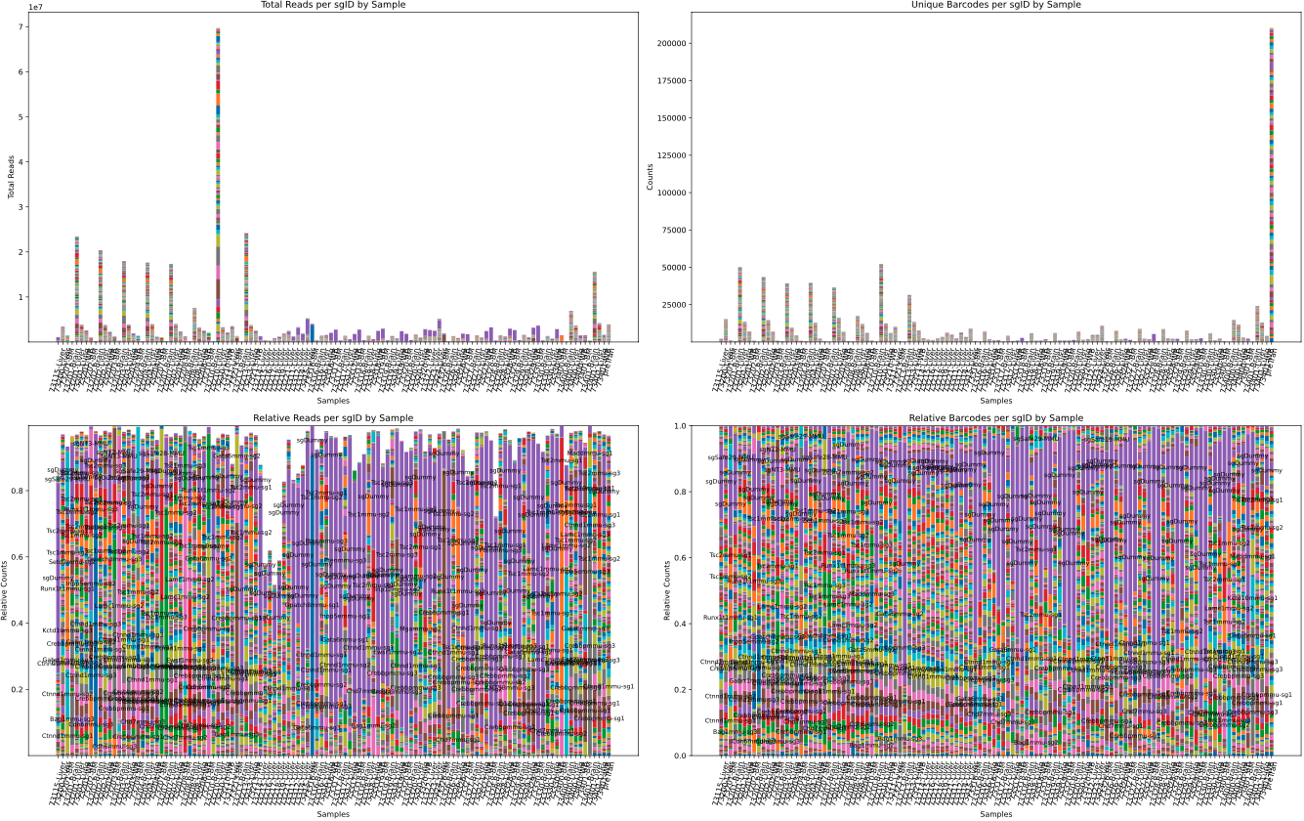

Slide 7
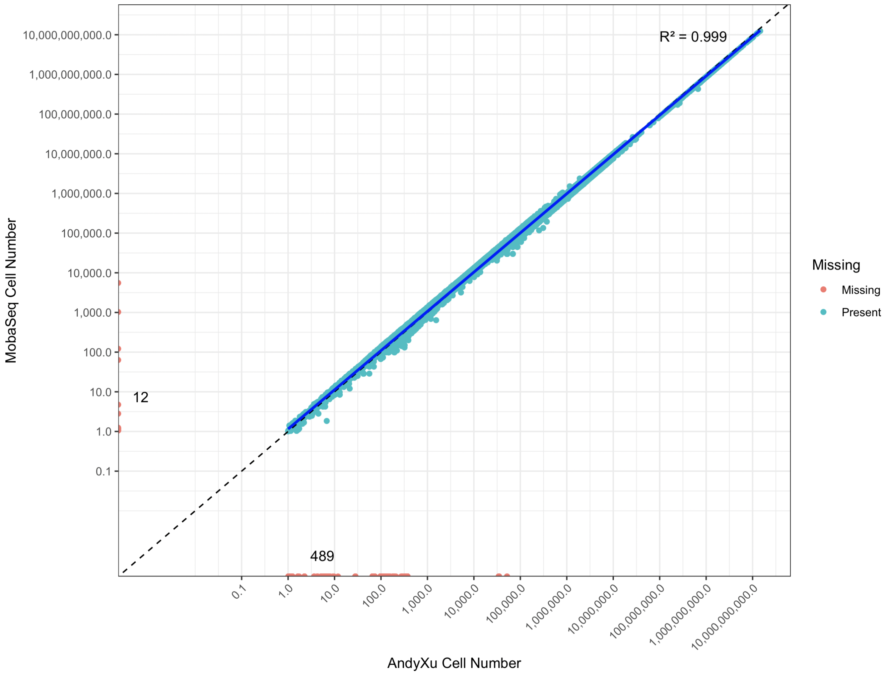
Major Changes
Created Python CLI for easier distribution and user friendly processing
Addressing BUG where R1_Barcode == R2_Barcode but R1_sgID =/= R2_sgID
Implemented new regression outlier removal utilizing expected cell_number distributions to remove SpikeIns that do not perform as expected
Implemented multithreading and parallel processing
Minor Changes
Changed algorithm for sgID matching to complete search rather than partial “best match” search
Allow individual sample processing as well as batch processing
Optimizations
Introduced alternative reading methods to speed up larger FASTQ input files
Utilizing NumPy to vectorize internal data manipulation
Implemented machine bye code version of Hamming Distance to improve computation
RunTime on MobaV FullSet (118 Samples)
Legacy Code → ~3 Days
Single Core → 1.5 Hours
8 Cores → 25 Minutes

Slide 8


Slide 9
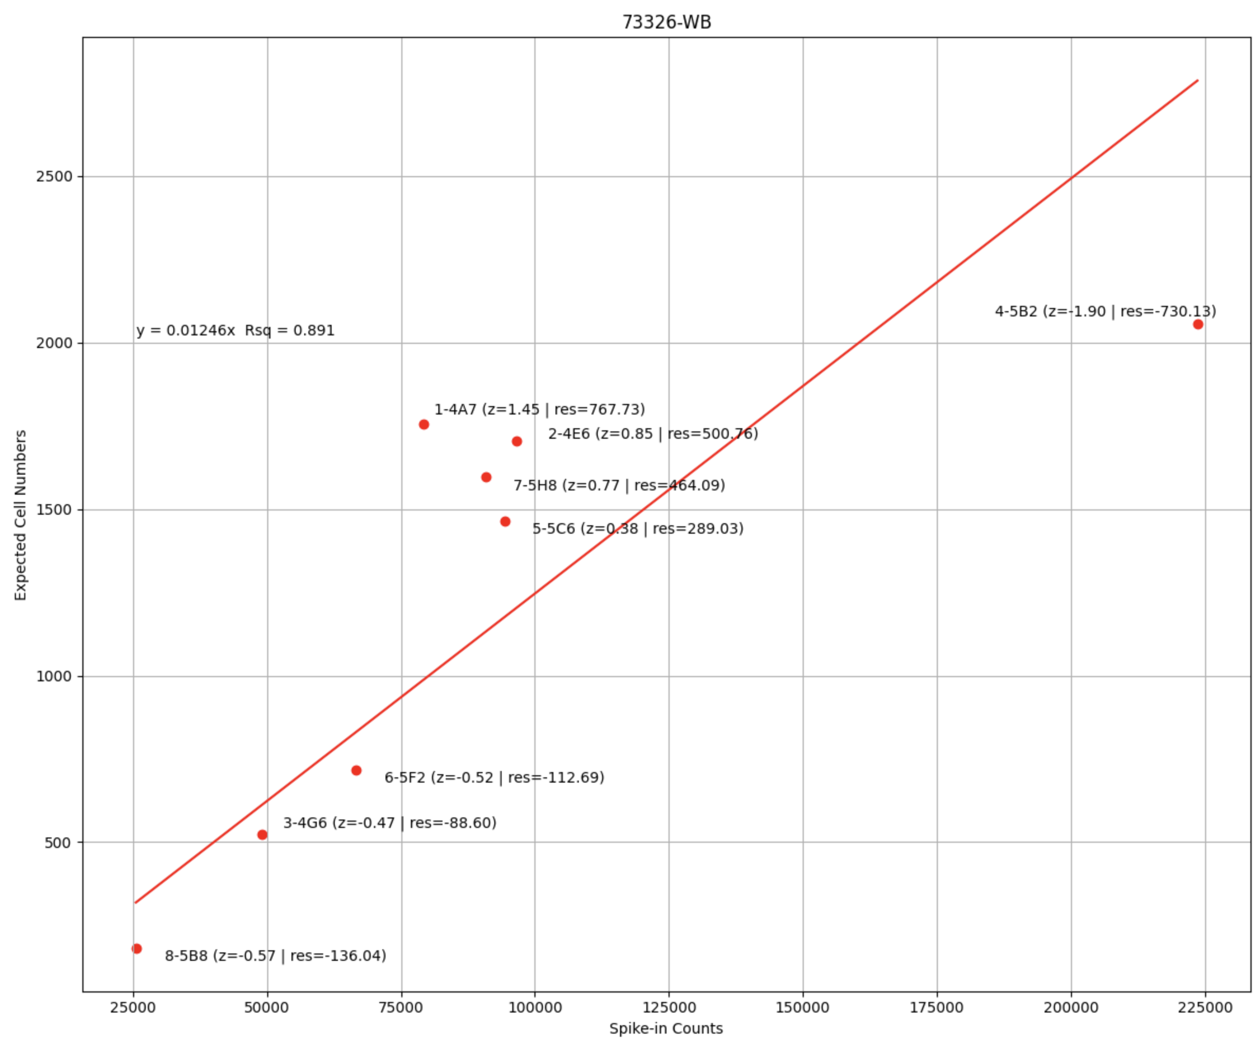
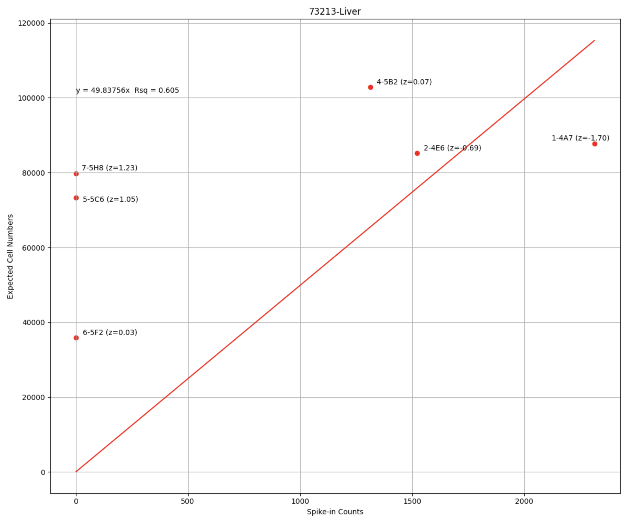
SpikeIn Outlier Removal
Legacy Algorithm
Utilizes Z-Score to explore SpikeIn distribution
If R² is less than 0.9, removes the SpikeIn with the largest deviation
Issues
Assumes SpikeIns are distributed along their expected values
Has issues dealing with SpikeIn Errors

Slide 10
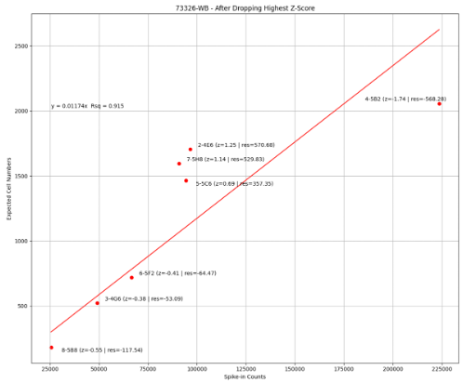
SpikeIn Outlier Removal
Legacy Algorithm
Utilizes Z-Score to explore SpikeIn distribution
If R² is less than 0.9, removes the SpikeIn with the largest deviation
Issues
Assumes SpikeIns are distributed along their expected values
Has issues dealing with SpikeIn Errors

Slide 11
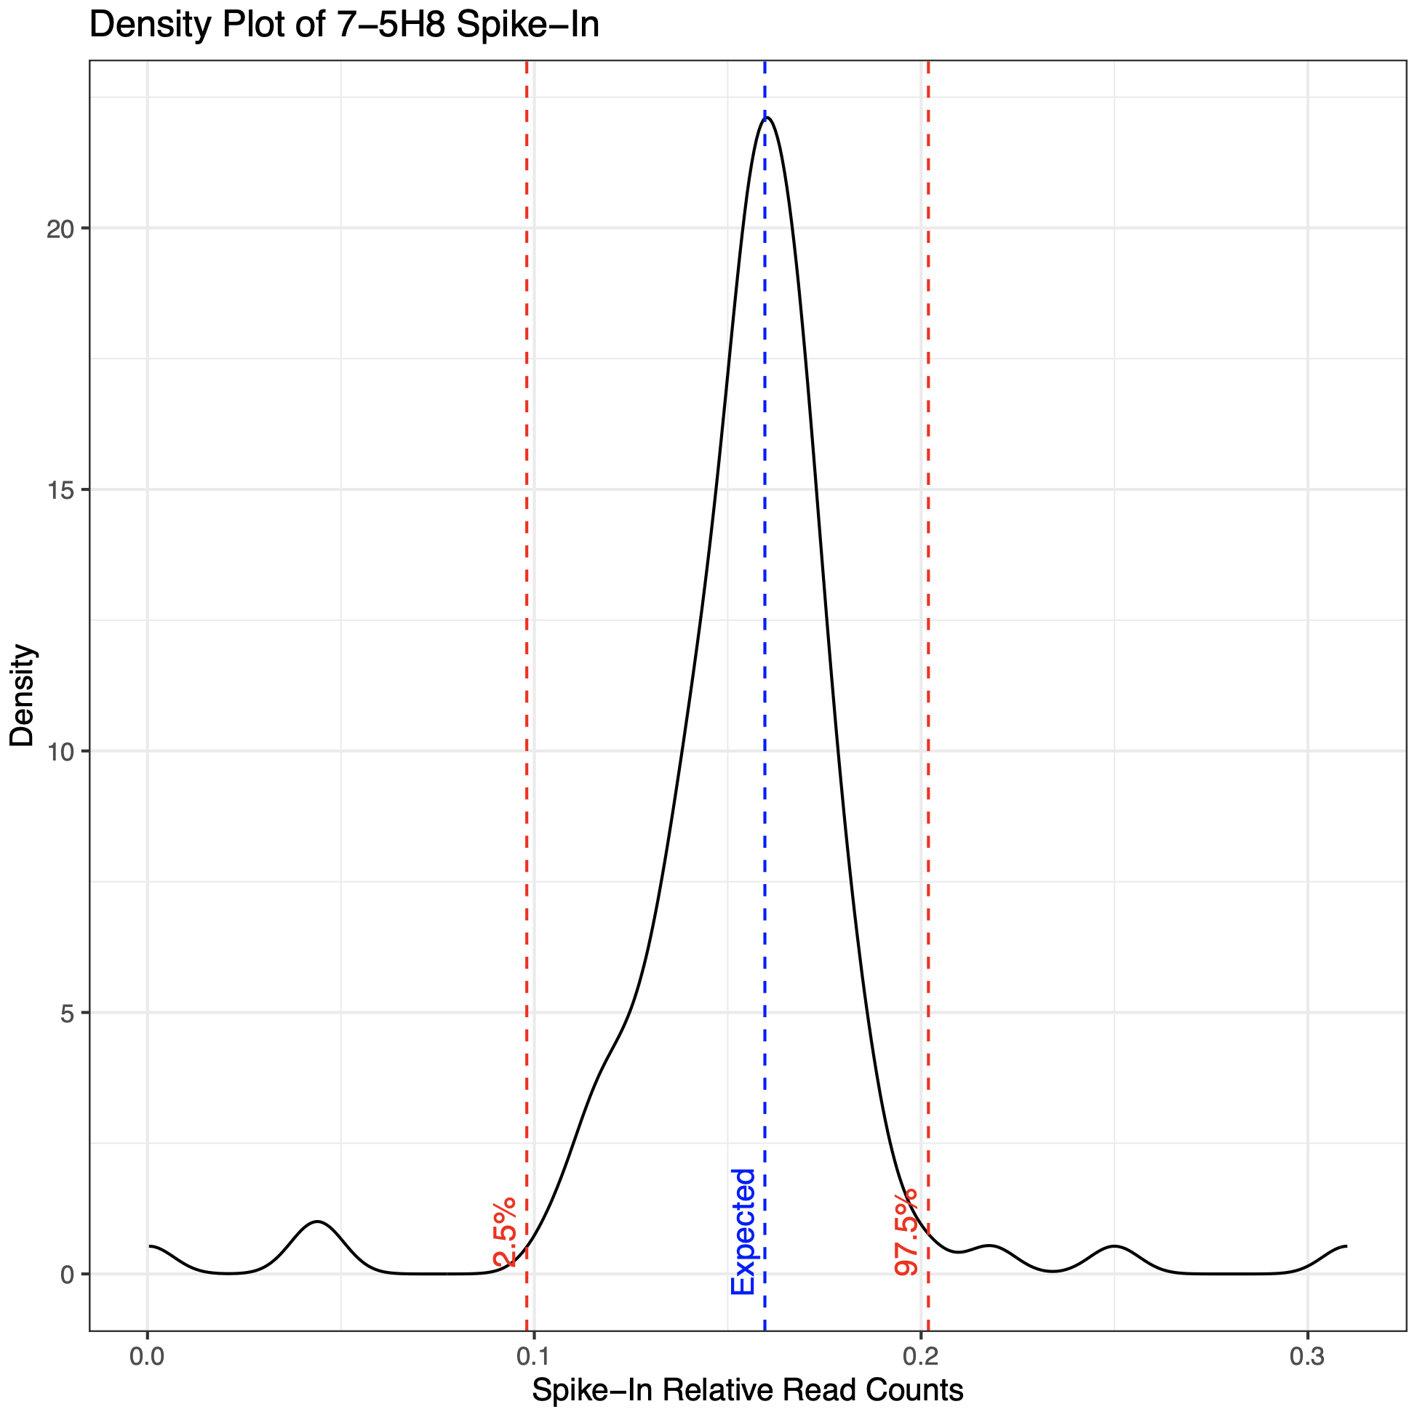
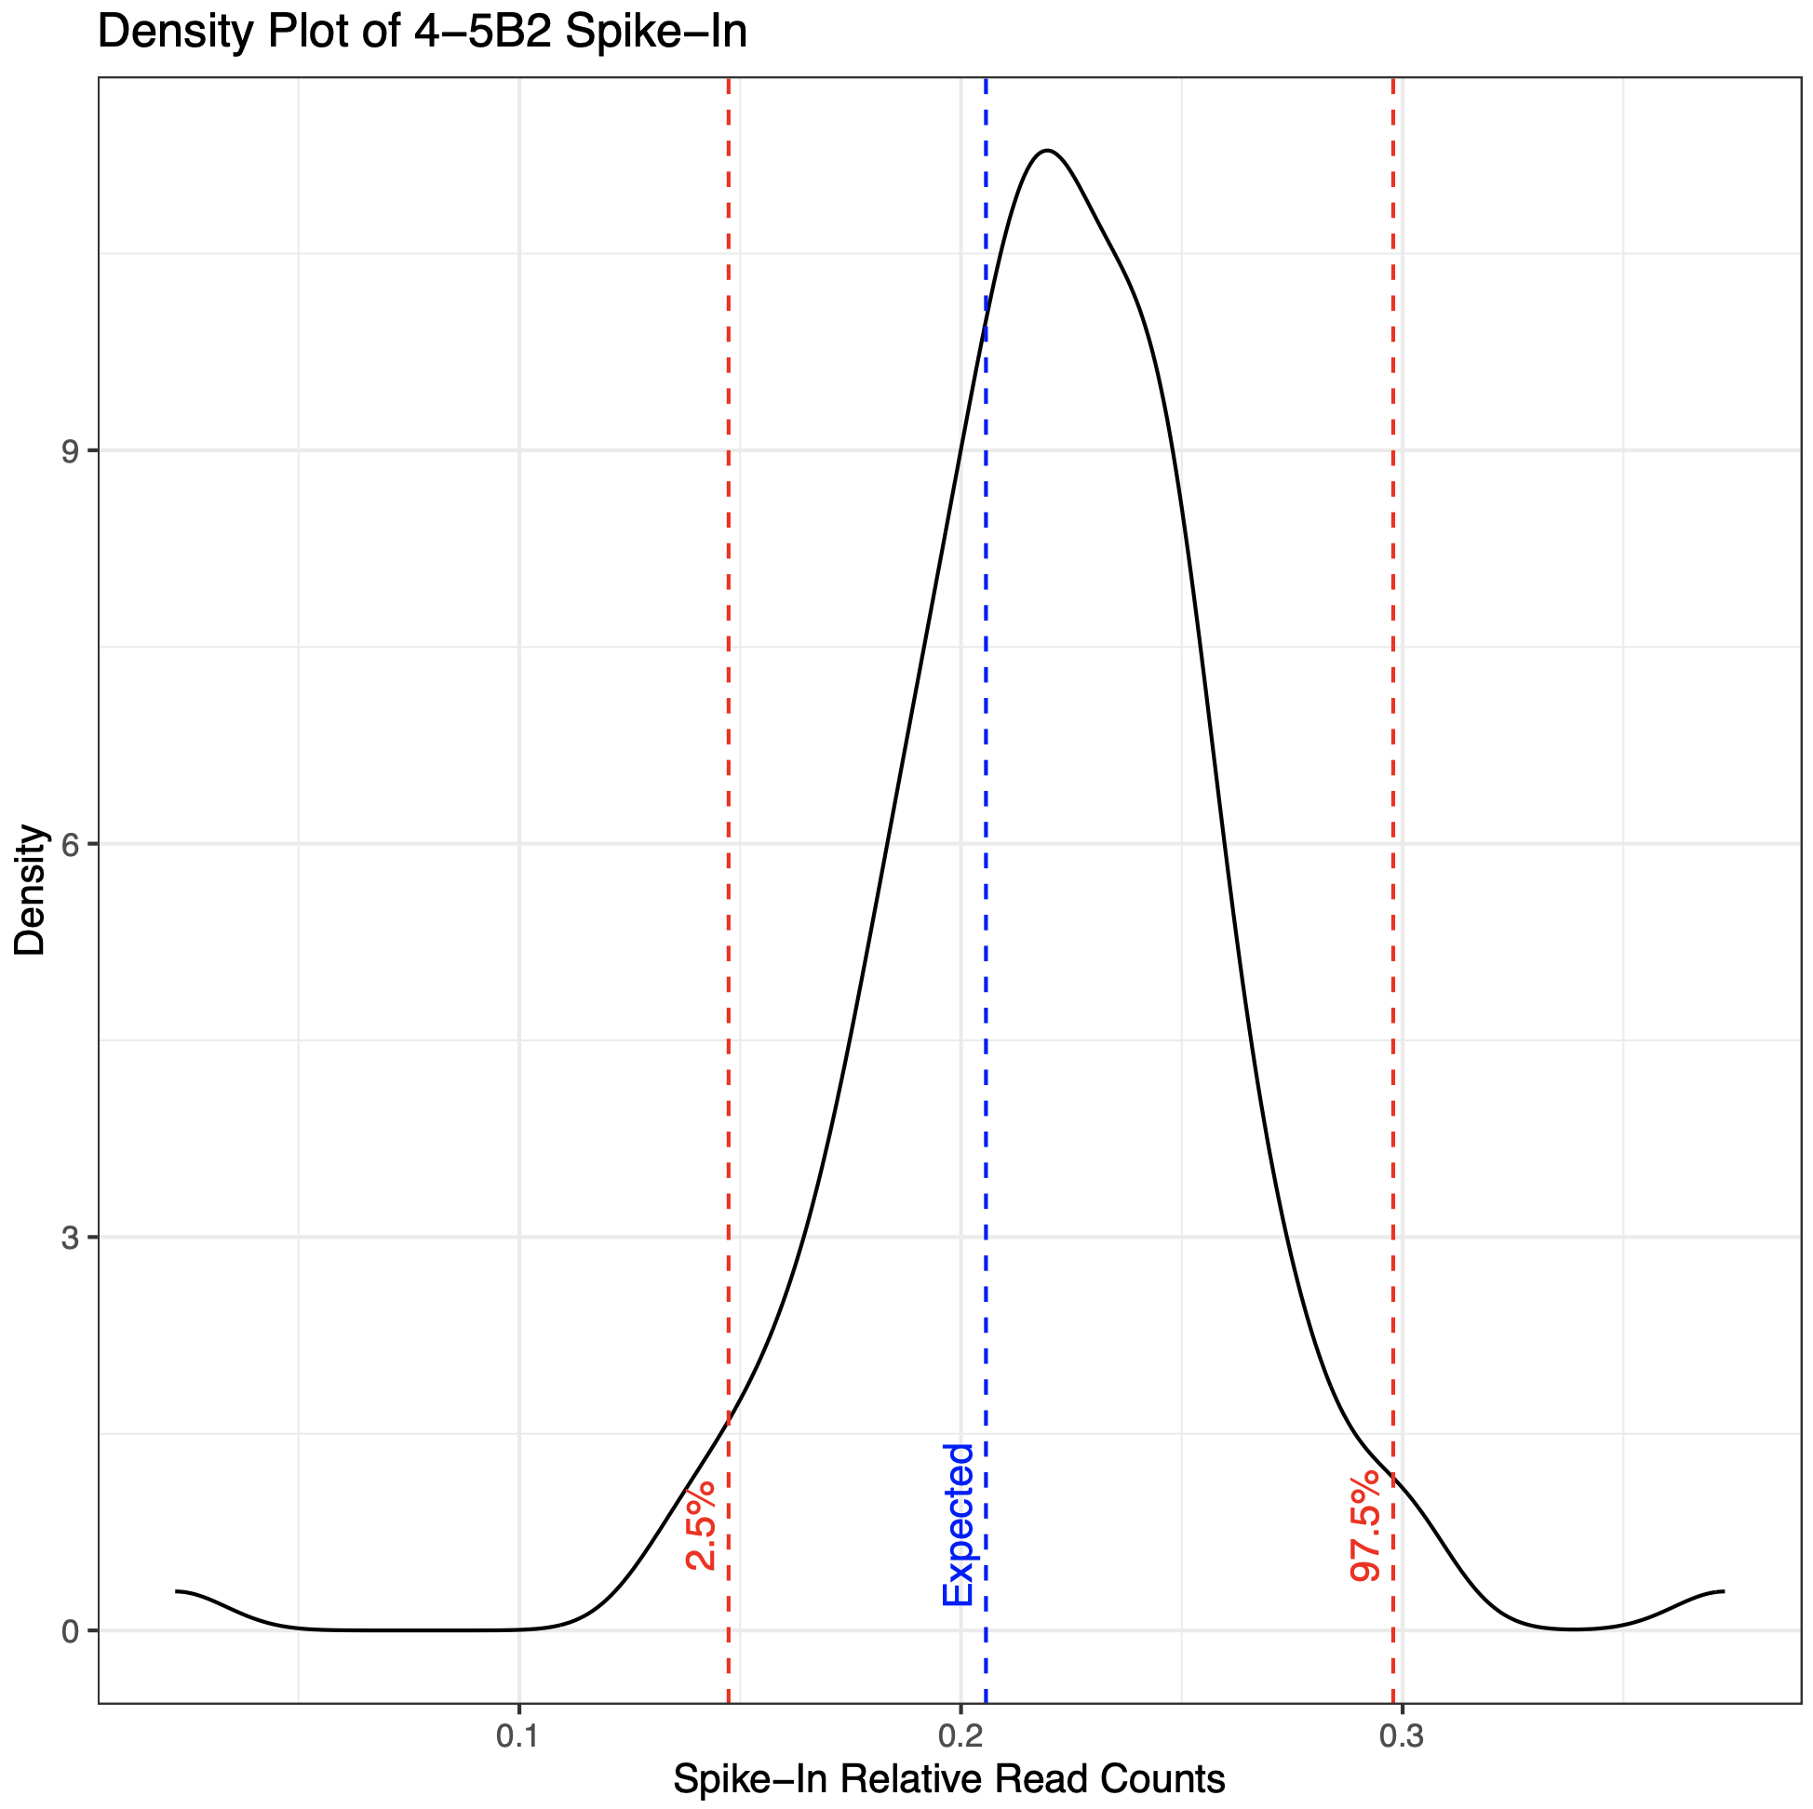
SpikeIn Outlier Removal

Slide 12
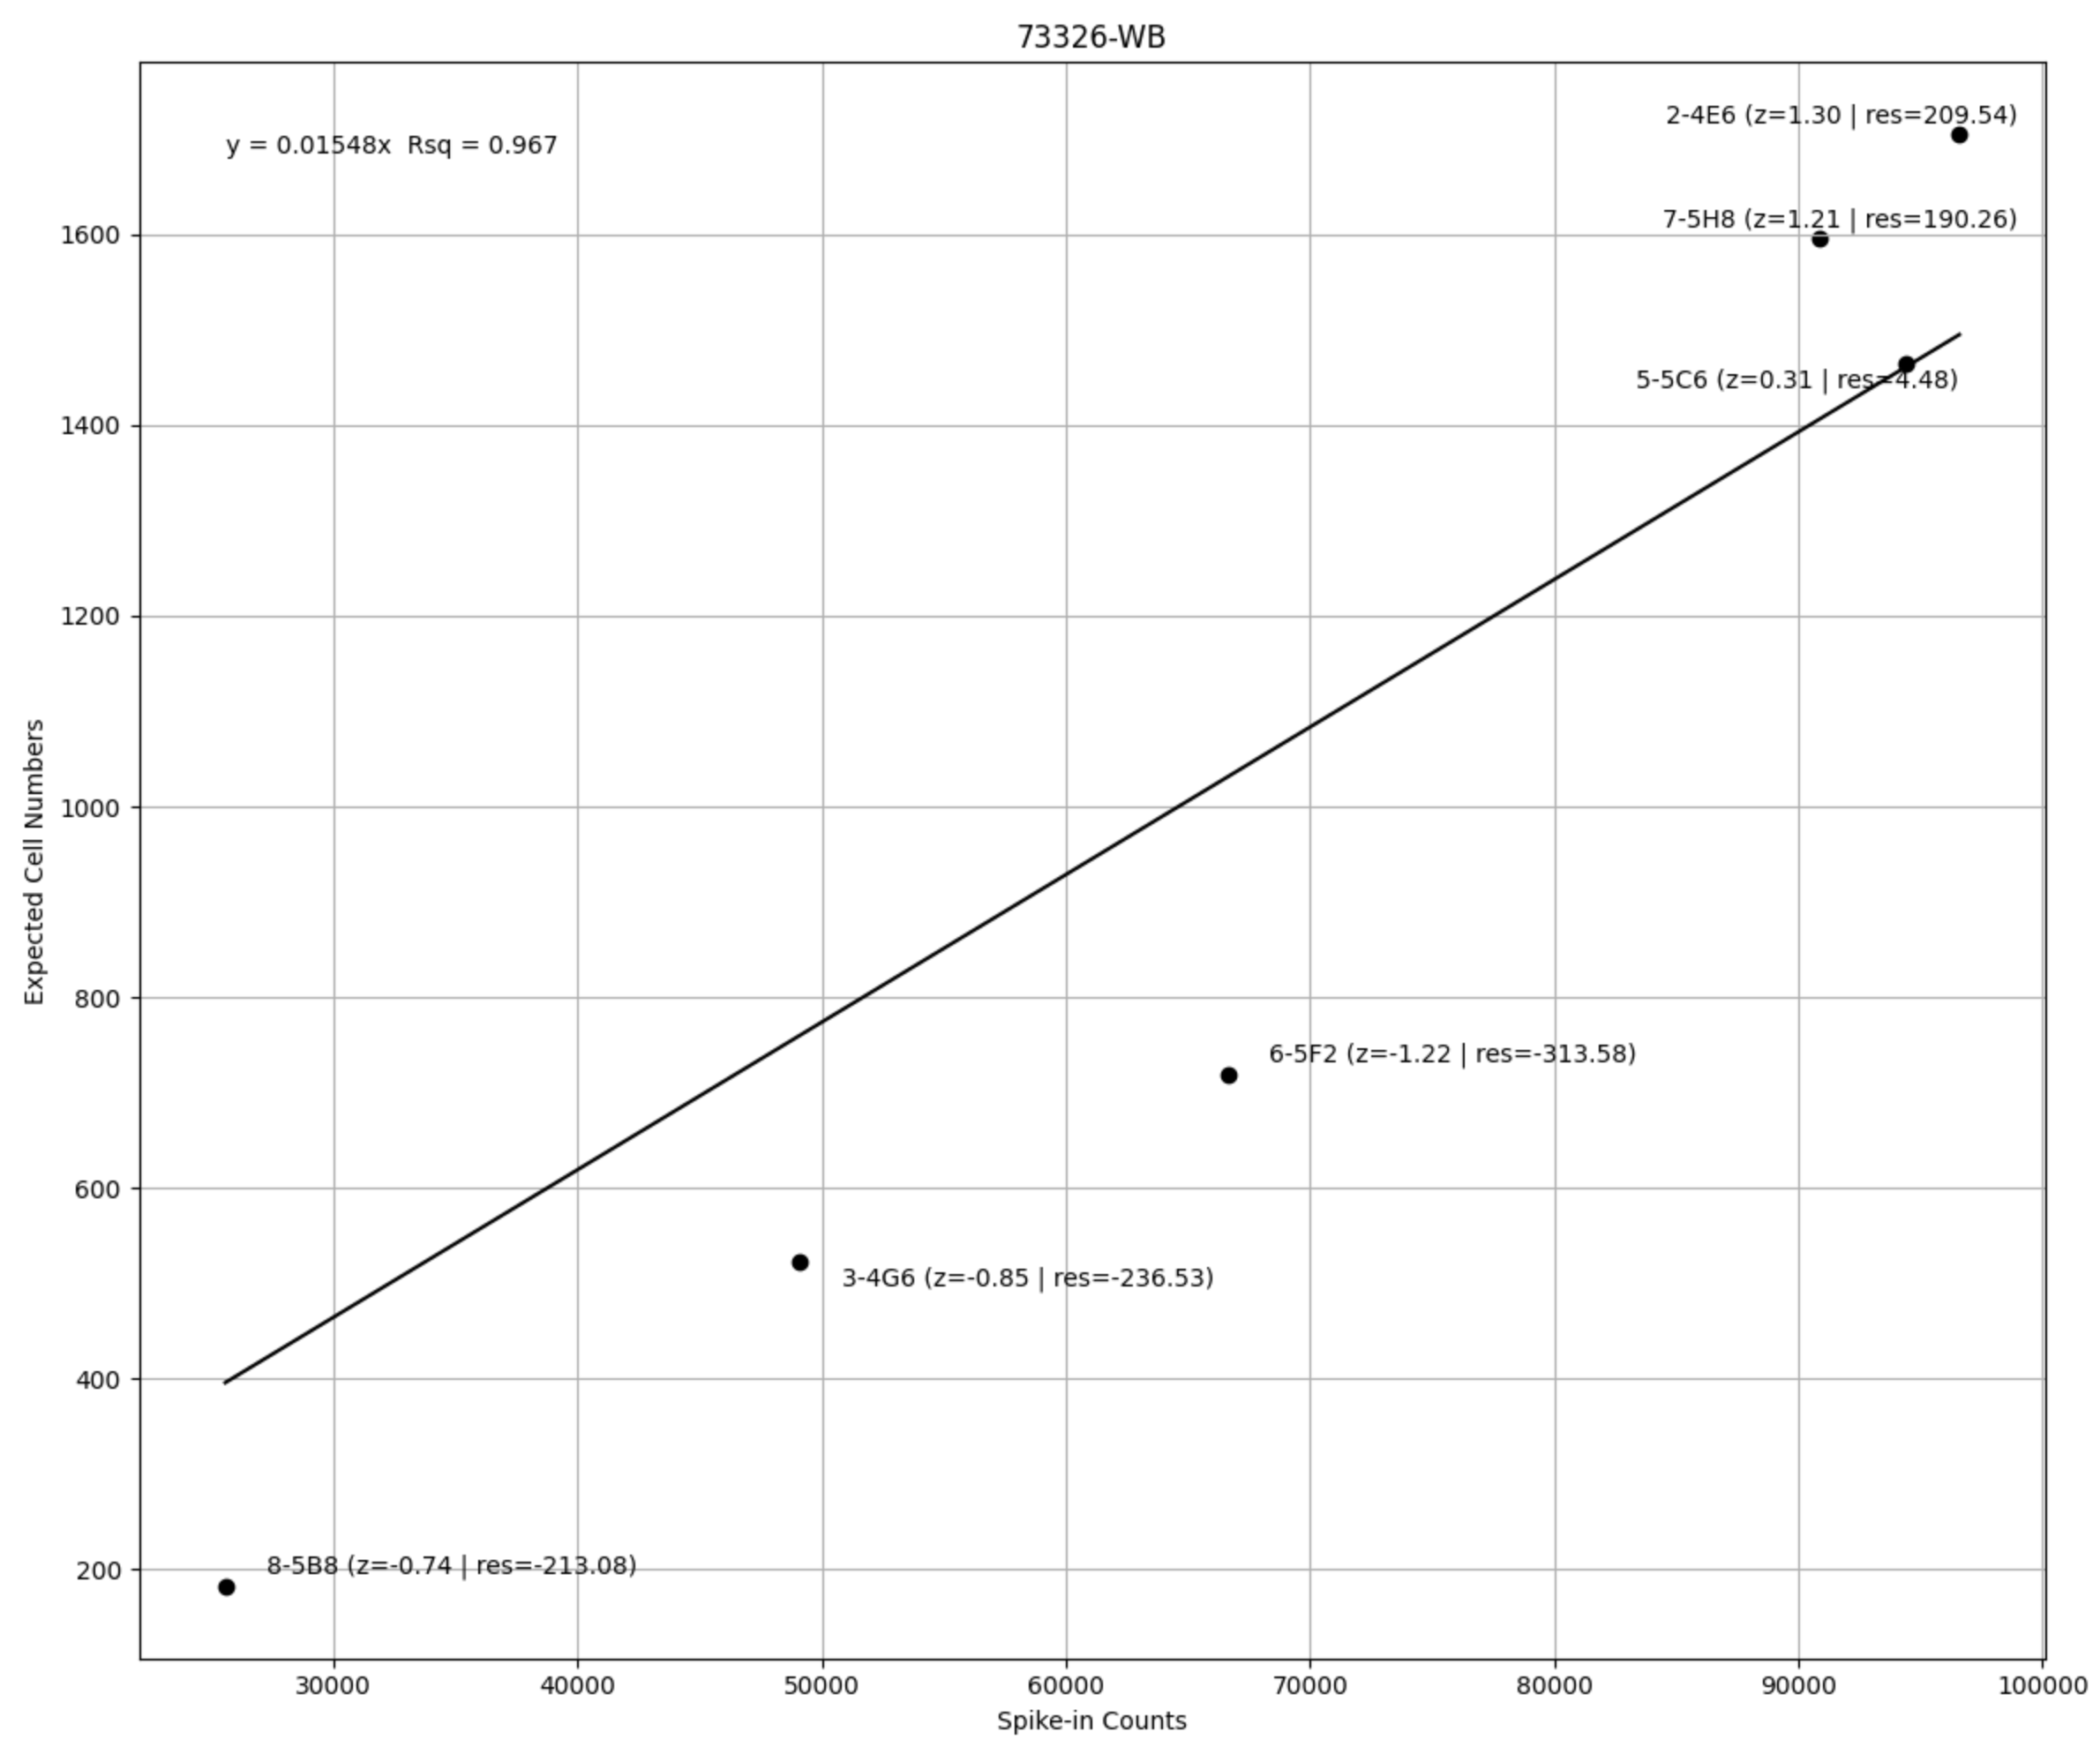
SpikeIn Outlier Removal

Slide 13
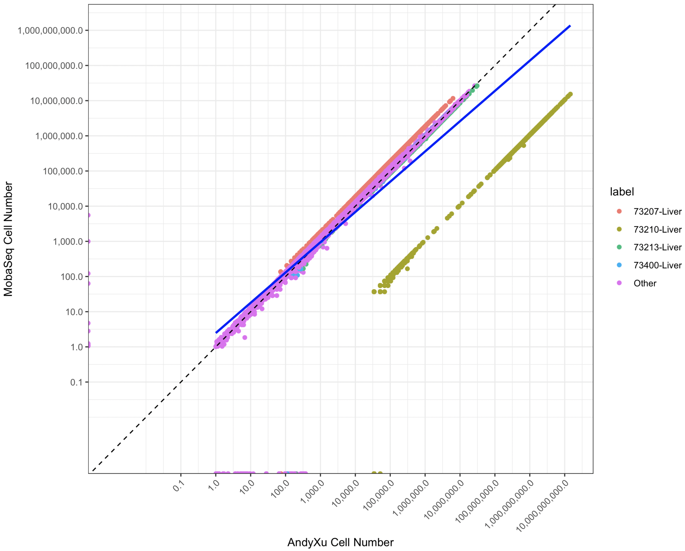
SpikeIn Outlier Removal

Slide 14
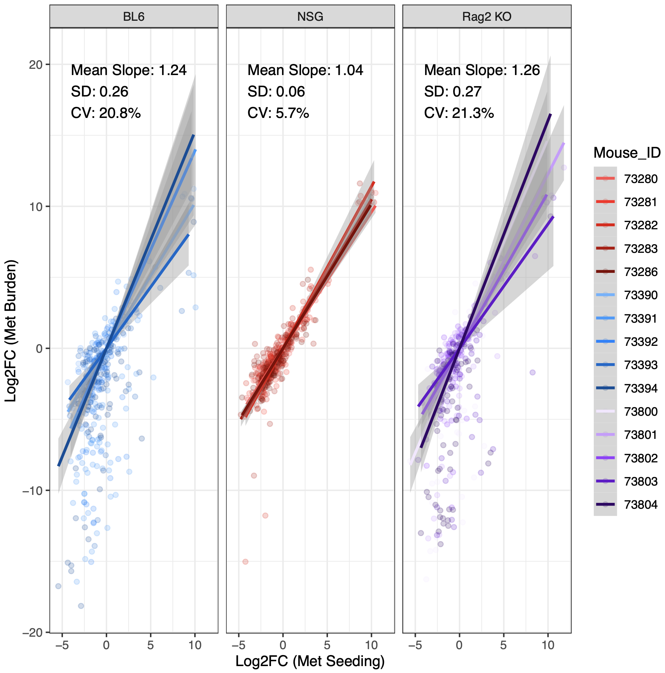
MobaV Immune
C57/BL6
Intact active and innate immune system
VS
NSG
Lacking both active and innate immune system
VS
Rag2 KO
Only lacking active immune system, has intact innate immune system

Slide 15
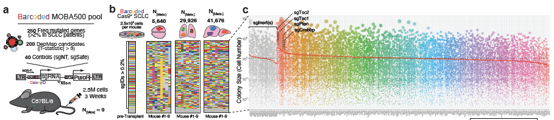
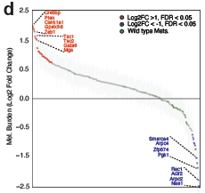
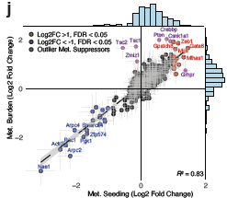
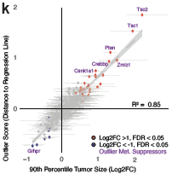
Crebbp Analysis

Slide 16
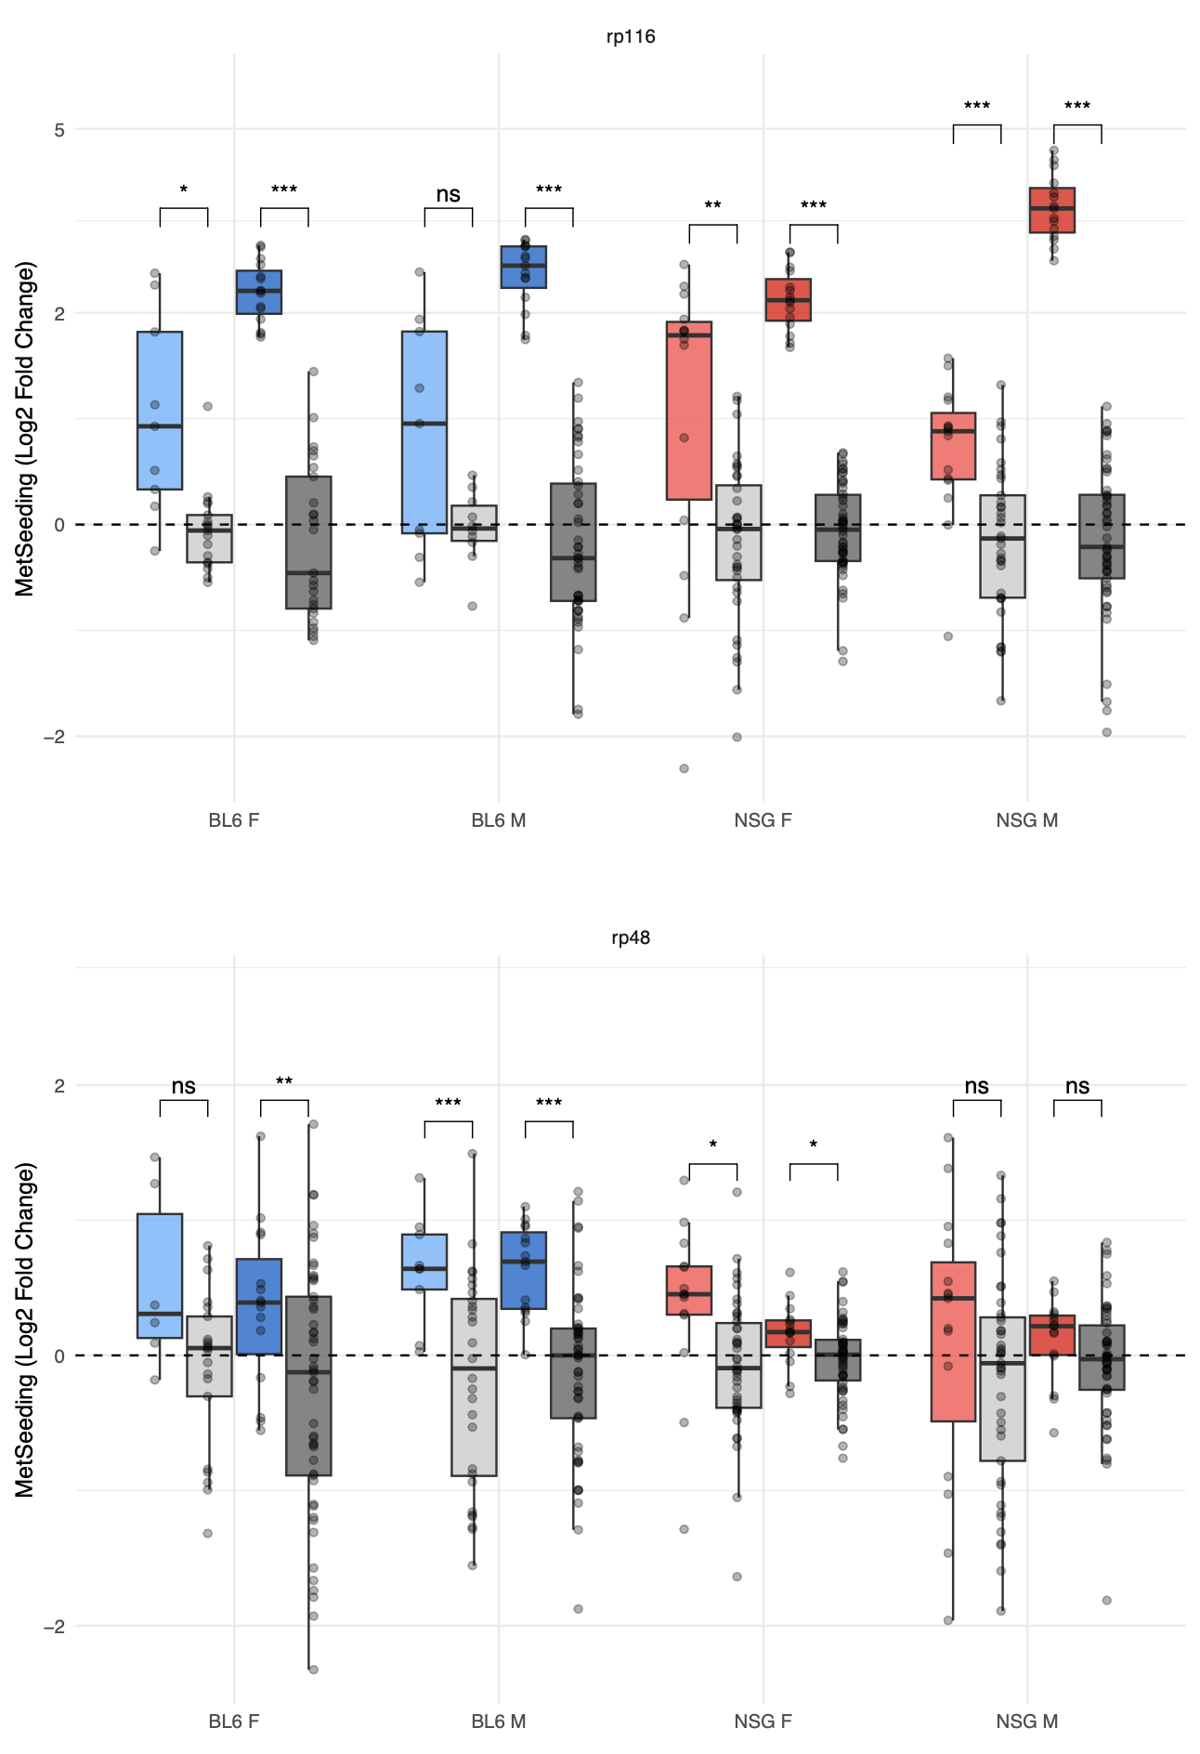
Crebbp Analysis – MetBurden & MetSeeding

Slide 17
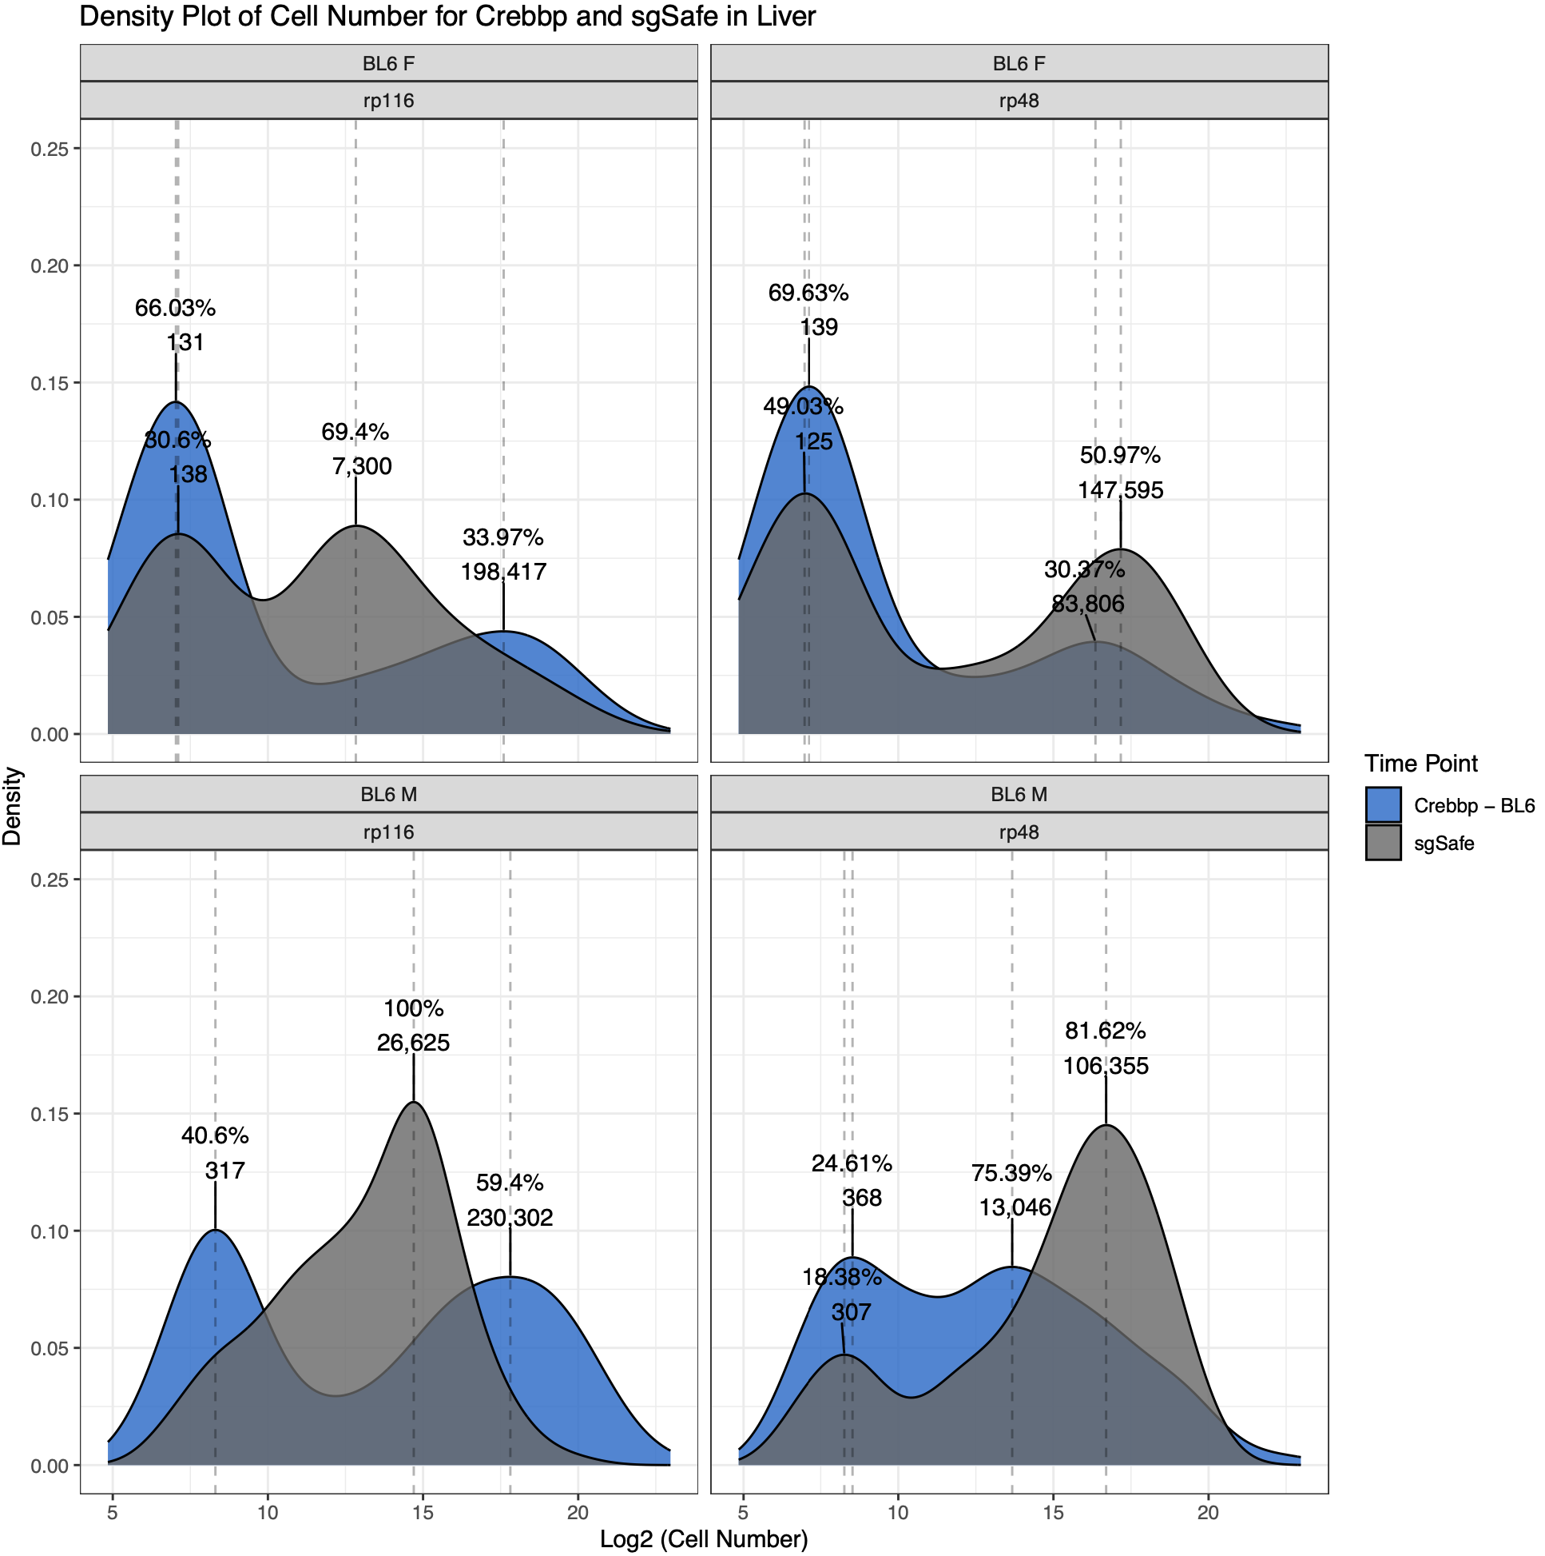
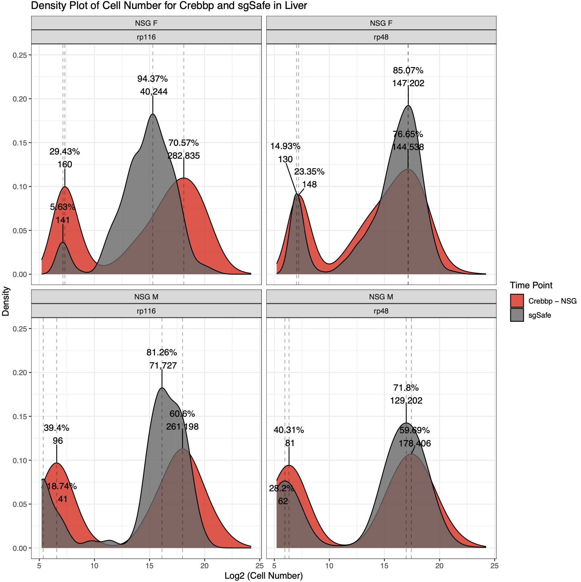
Crebbp Analysis - Dormancy

Slide 18
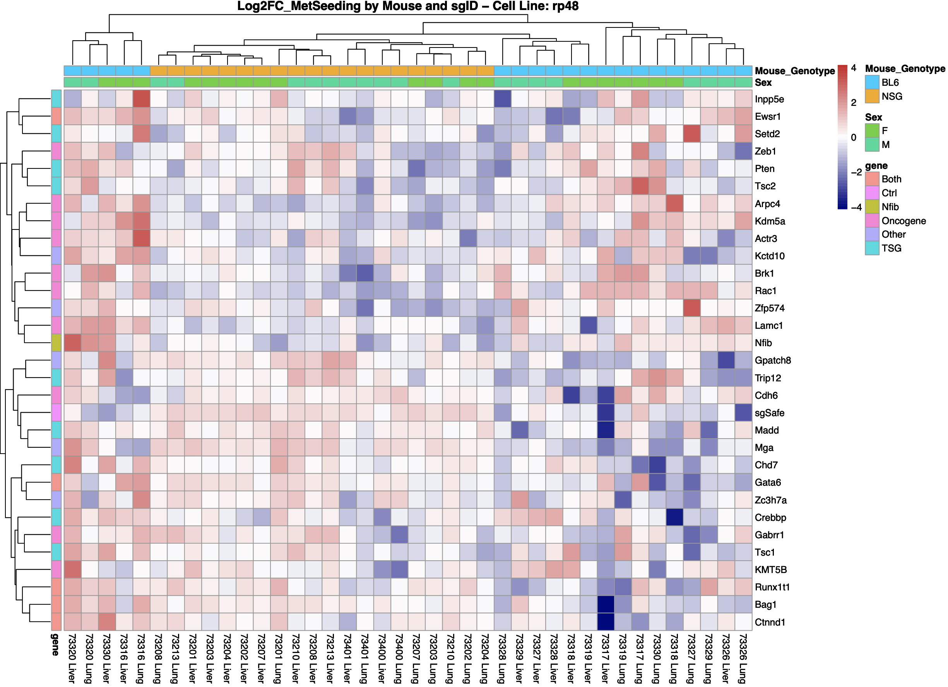
MobaV FullSet - Environmental Factors

Slide 19
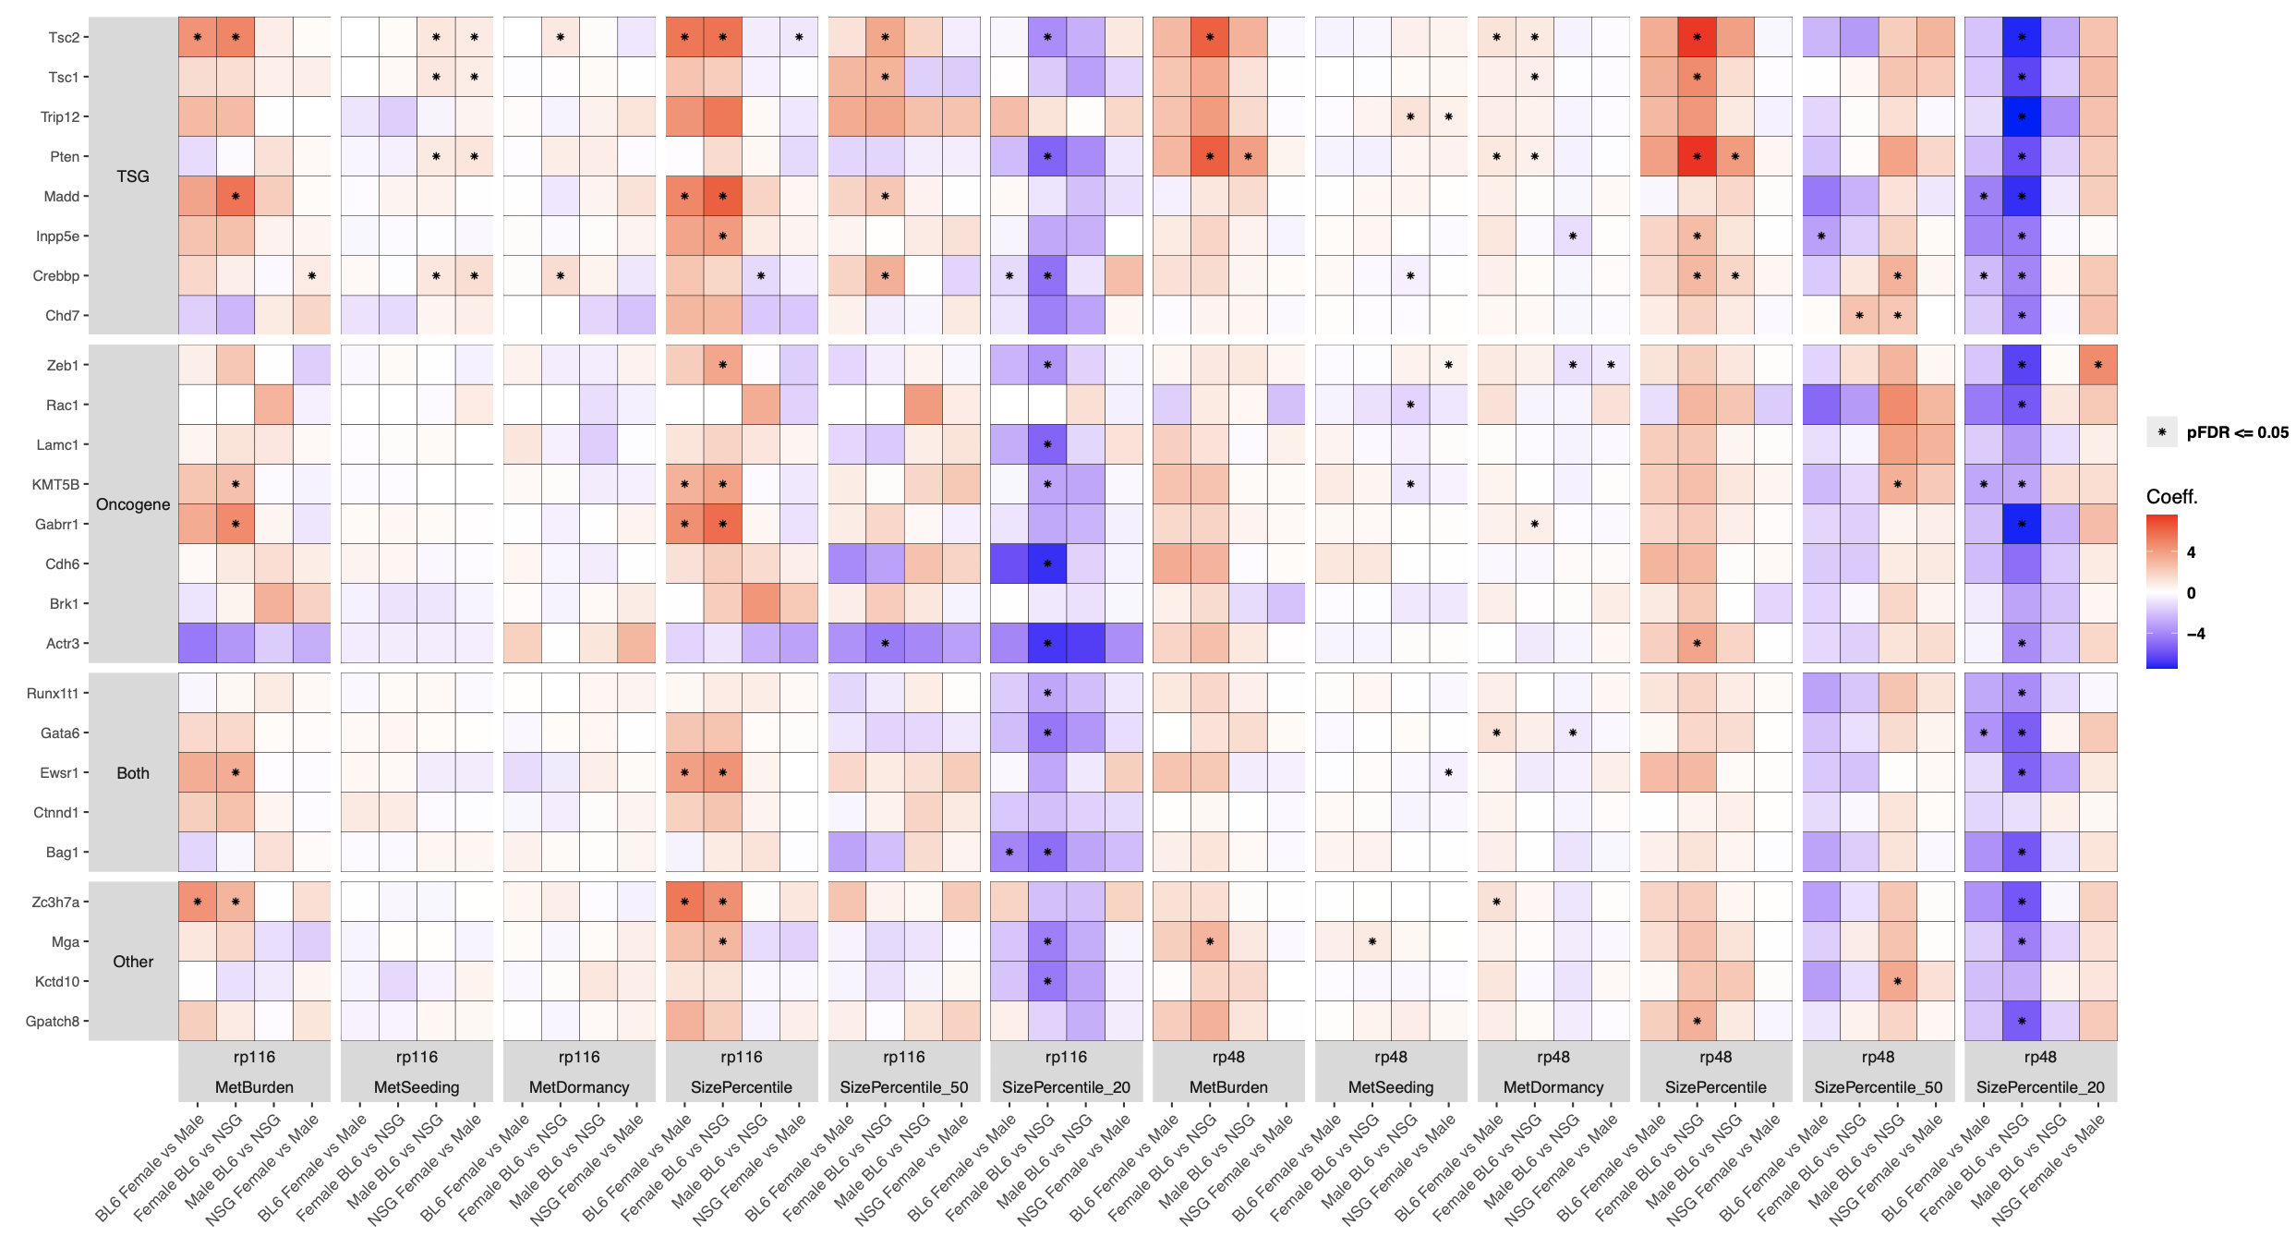
MobaV FullSet – Environmental Factors

Slide 20
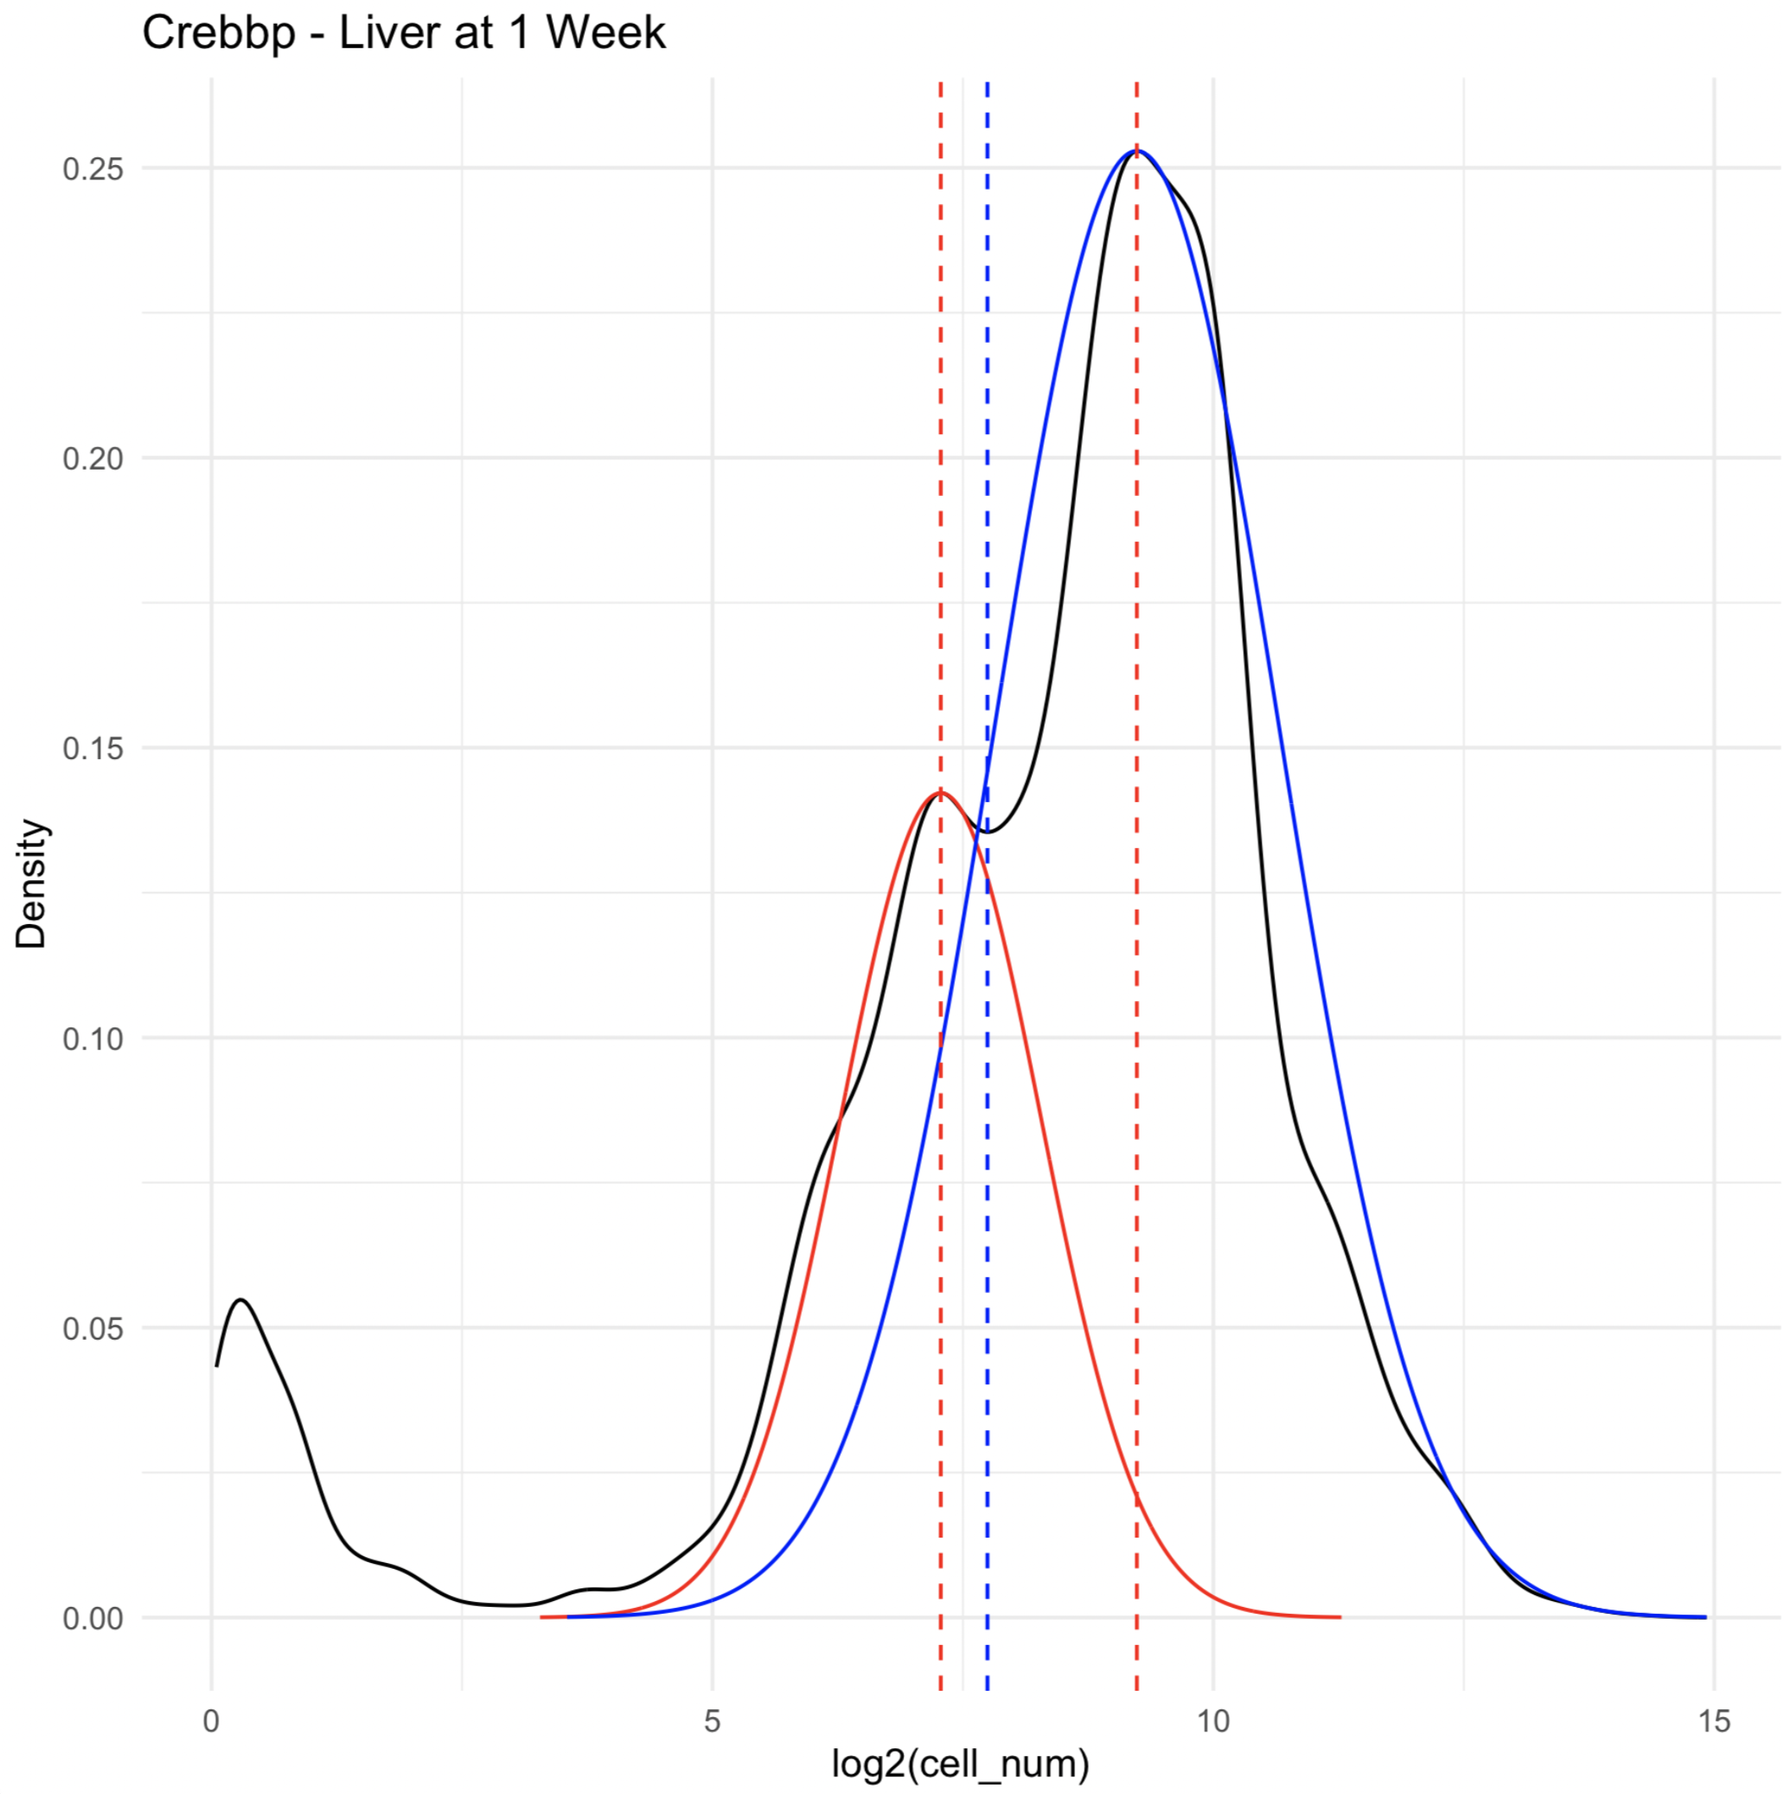
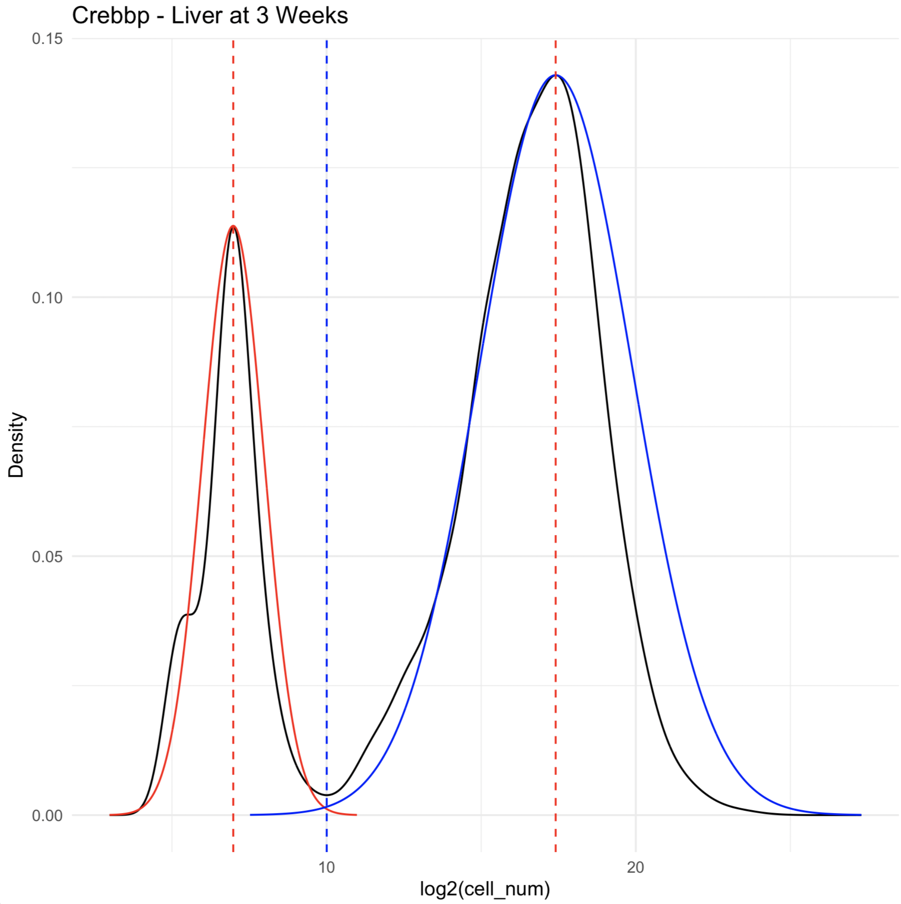

Slide 21
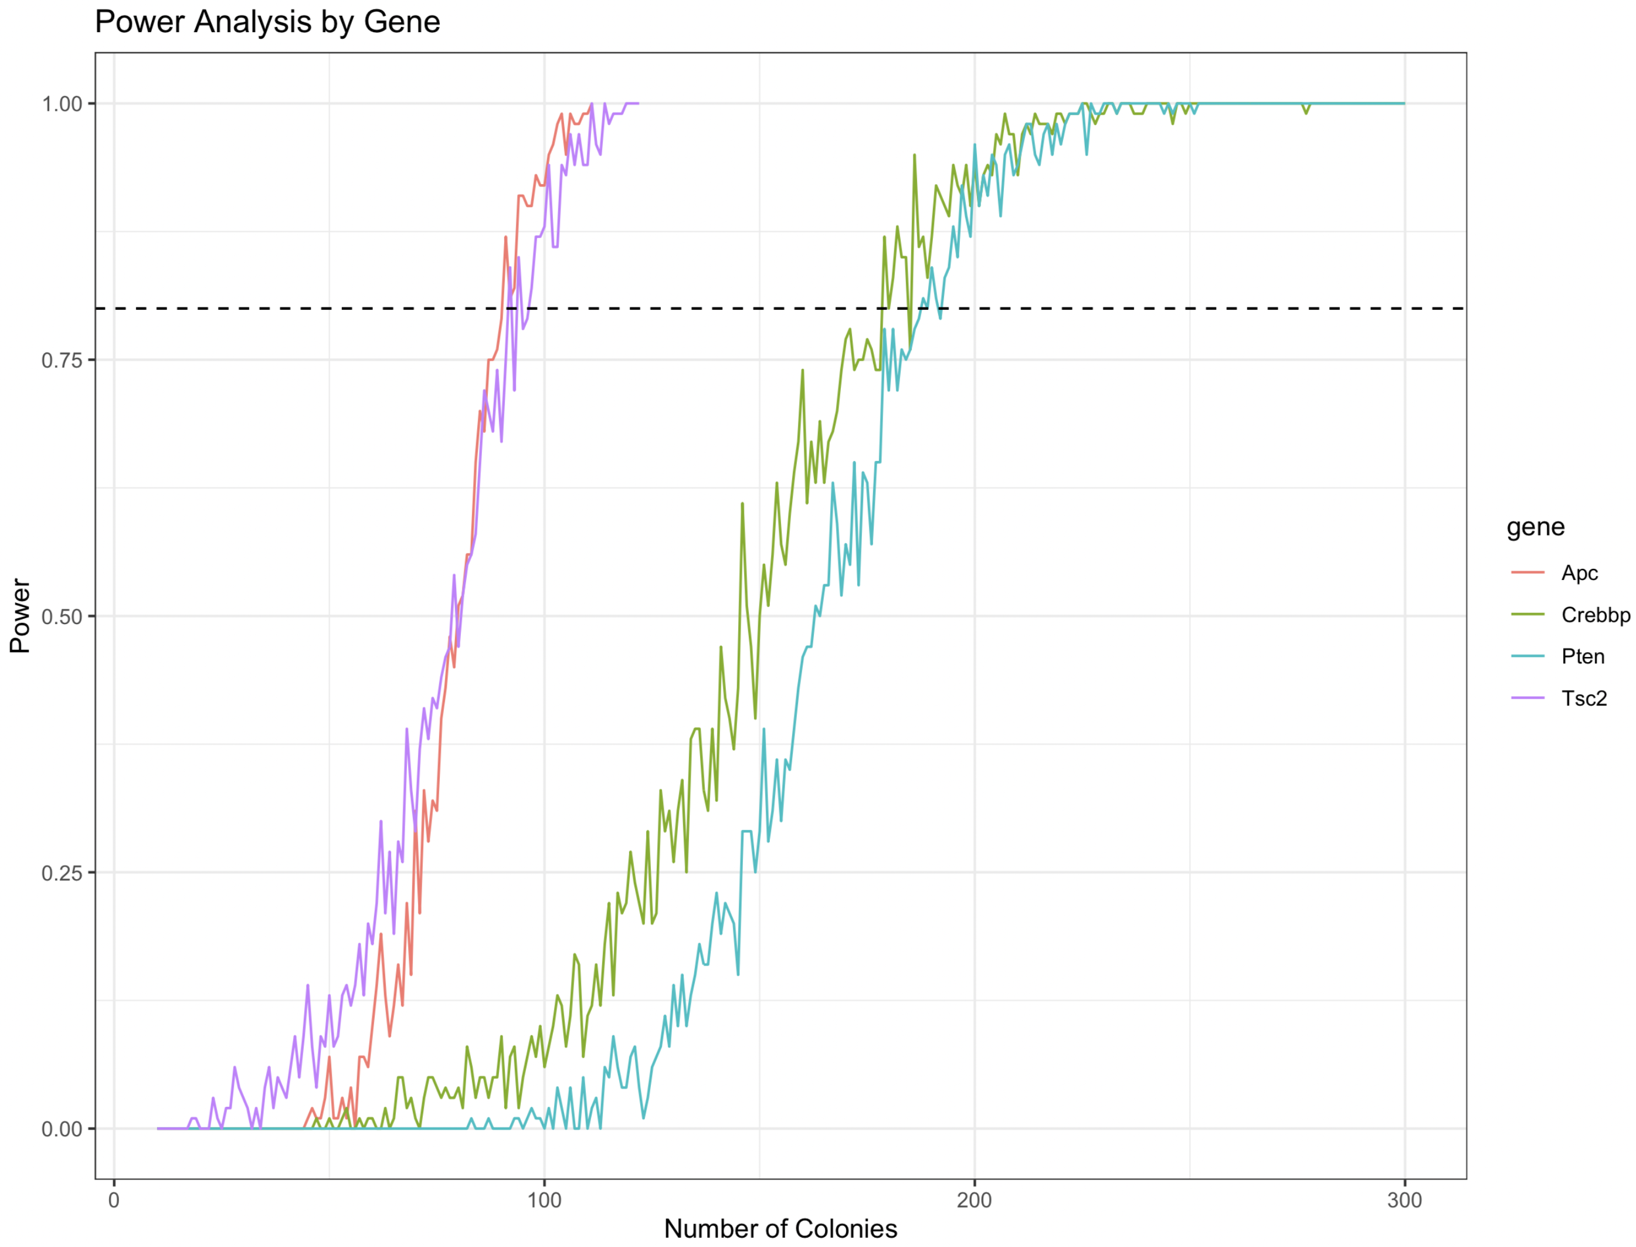
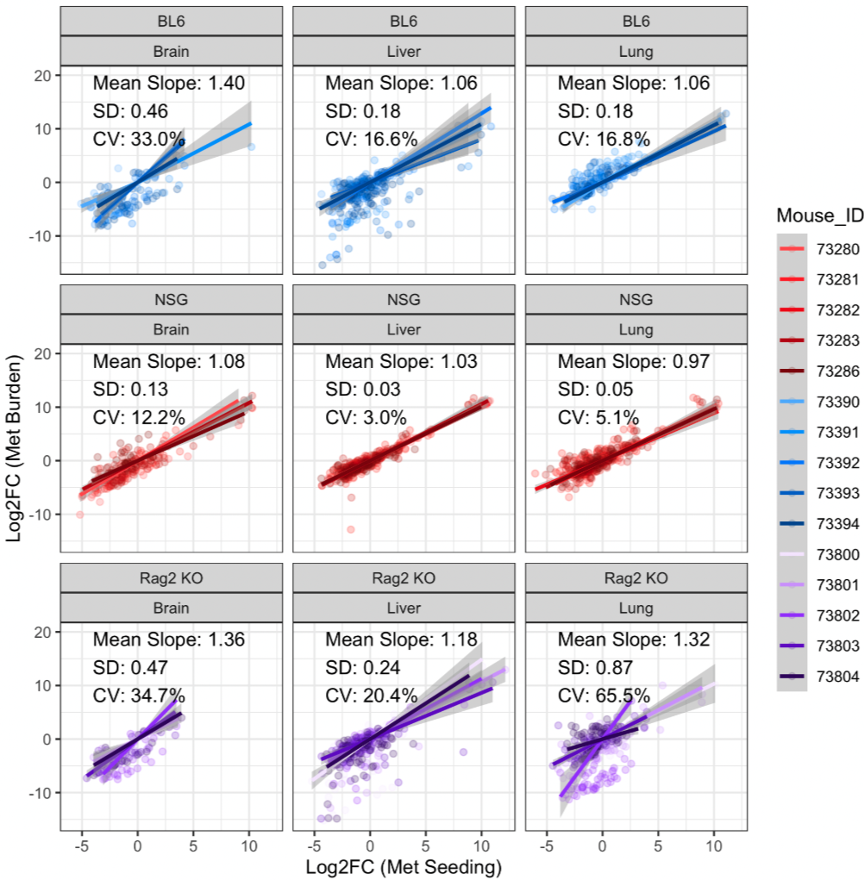
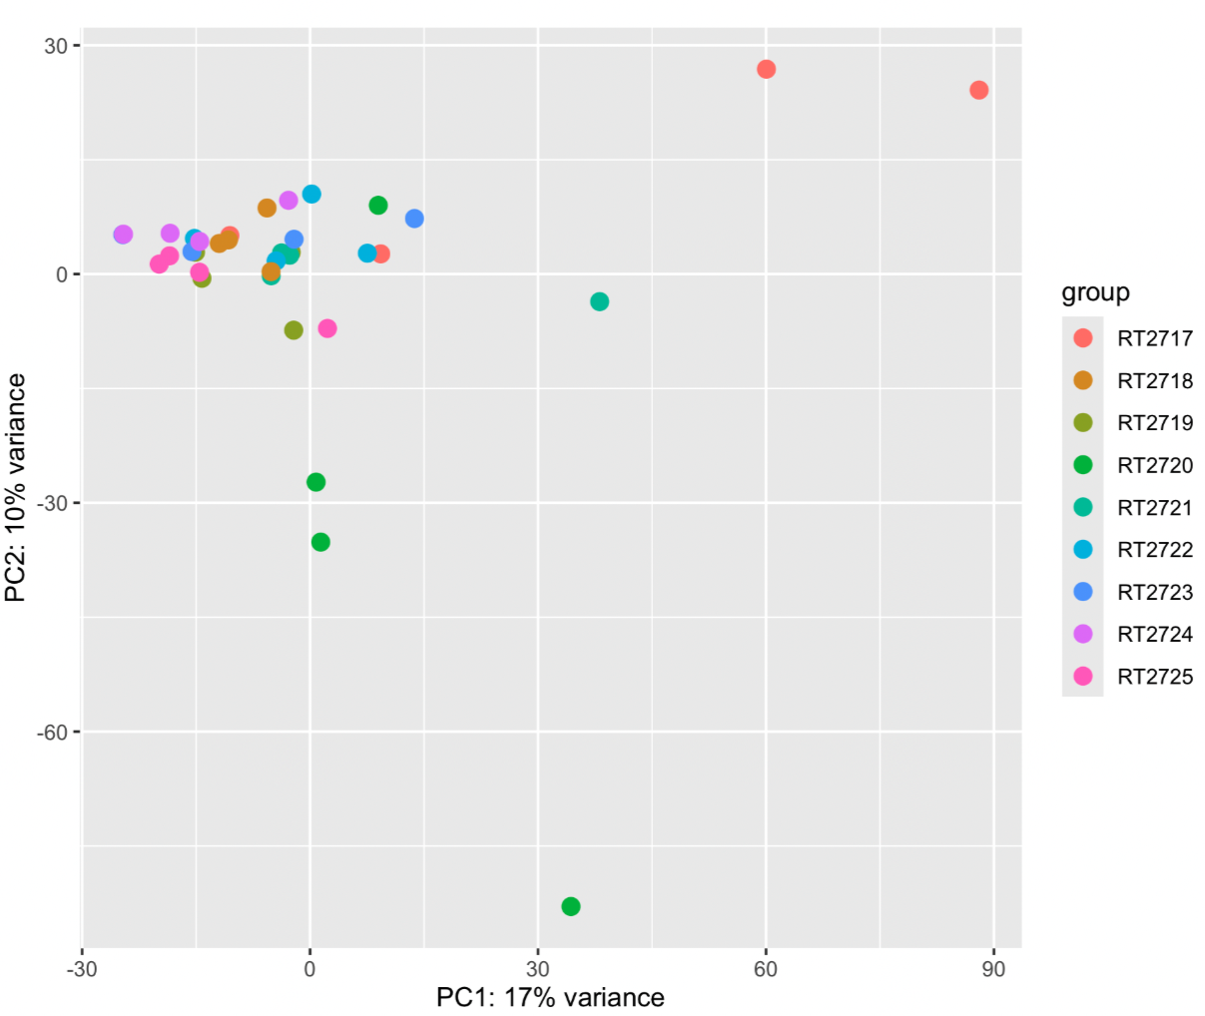
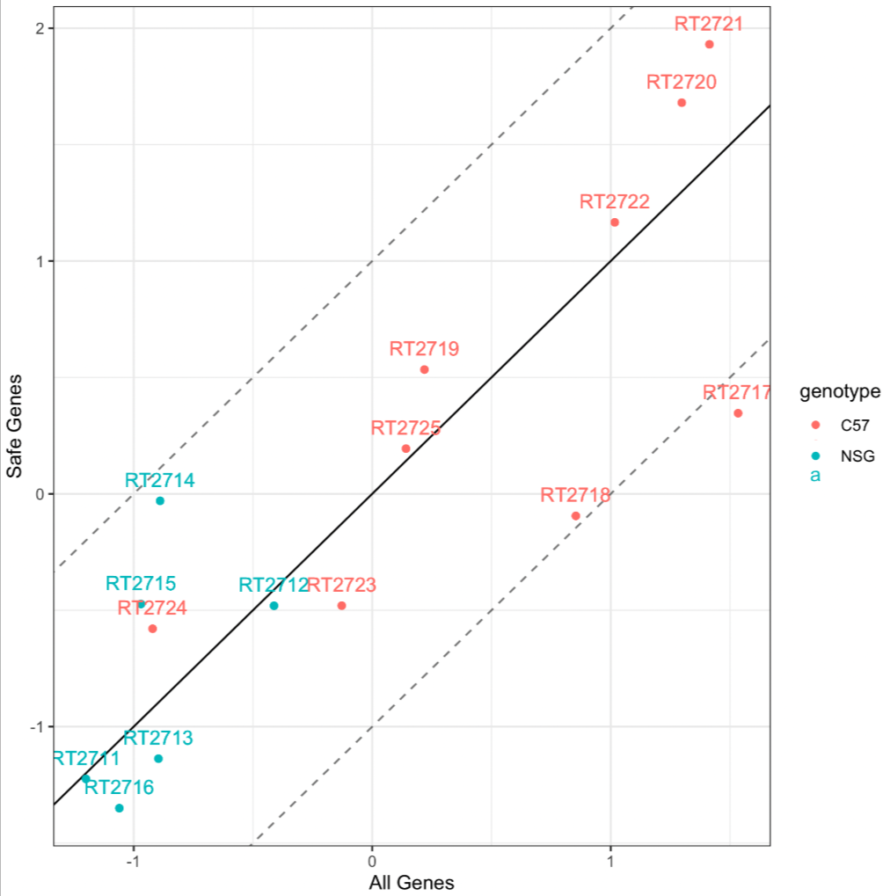
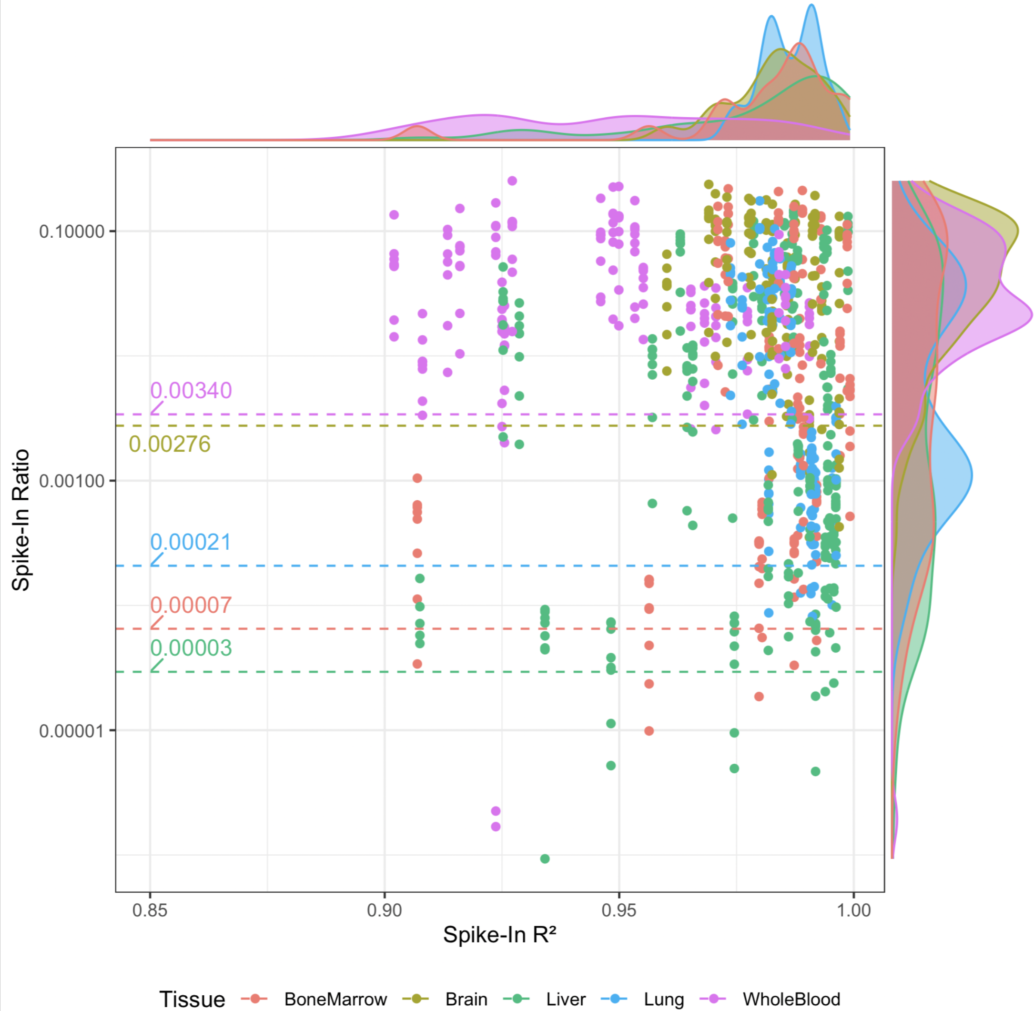
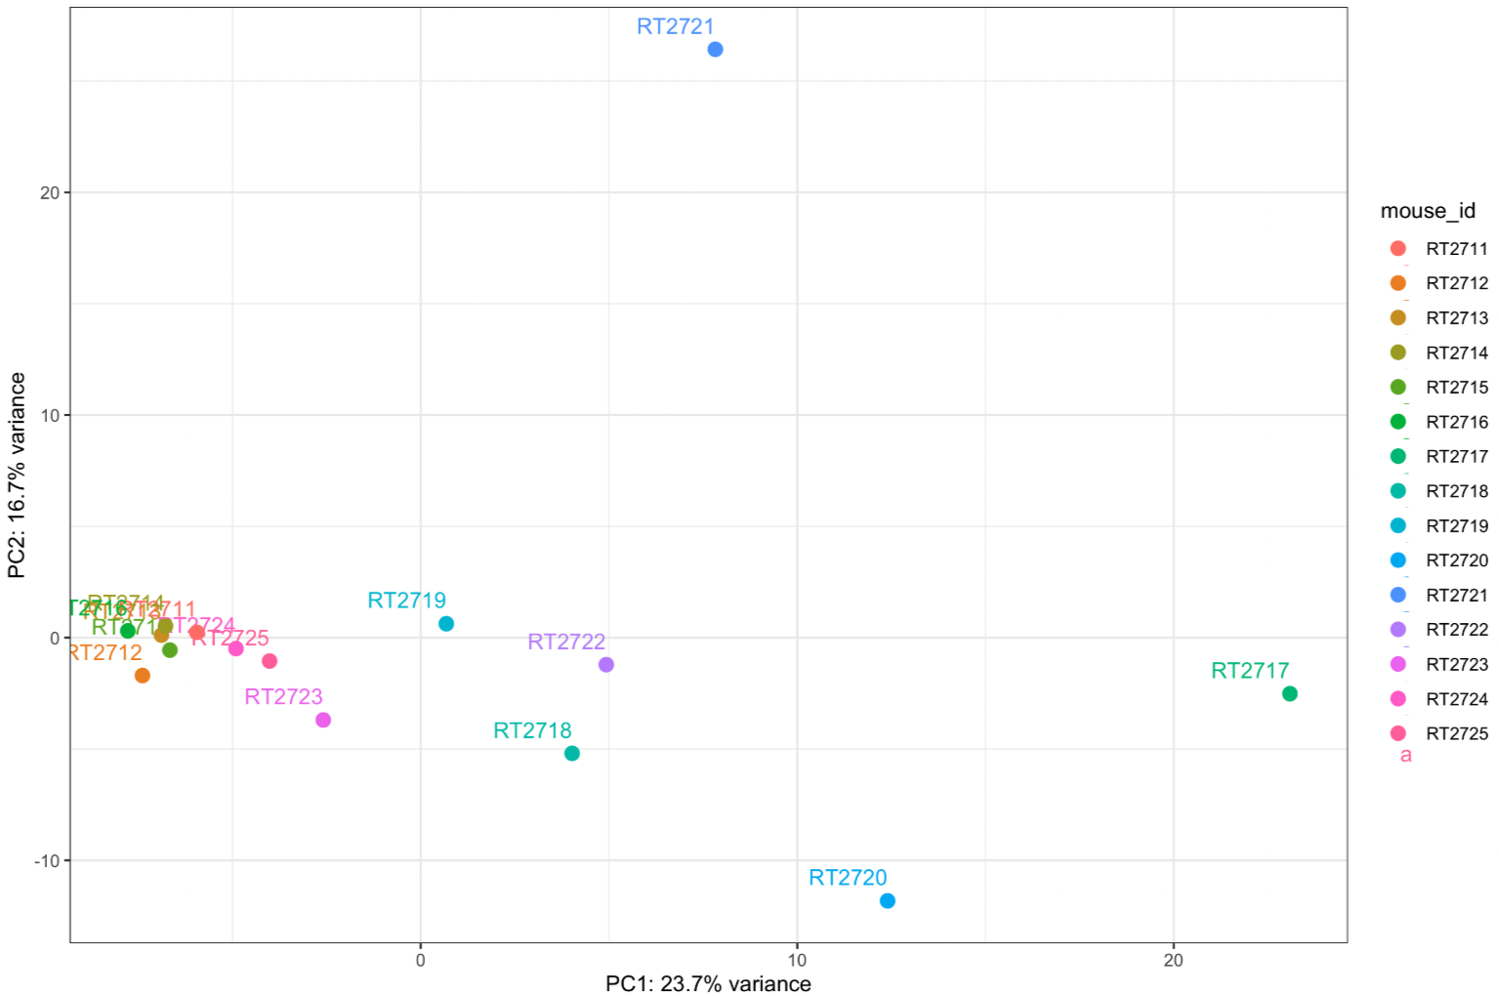
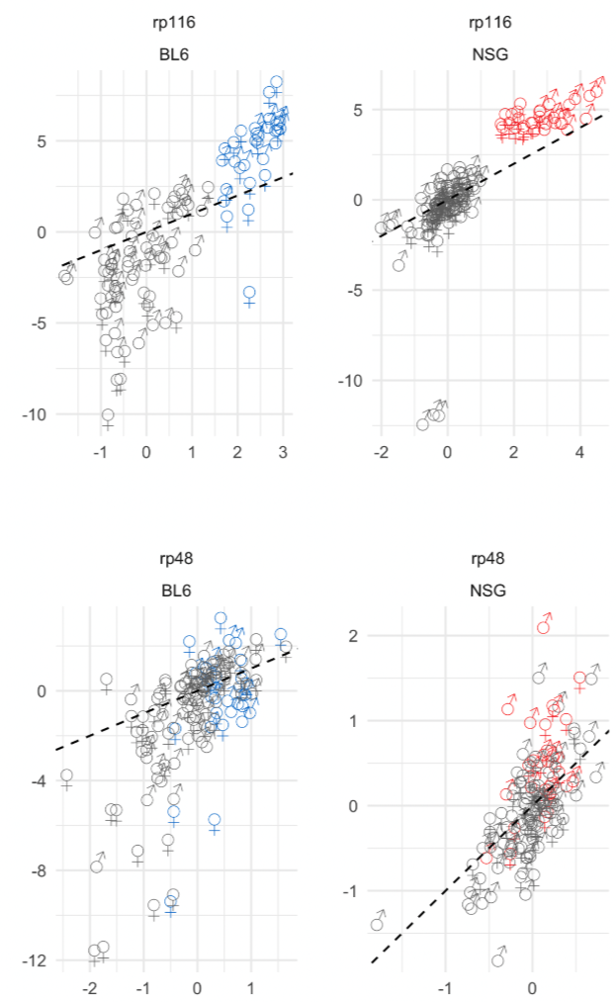
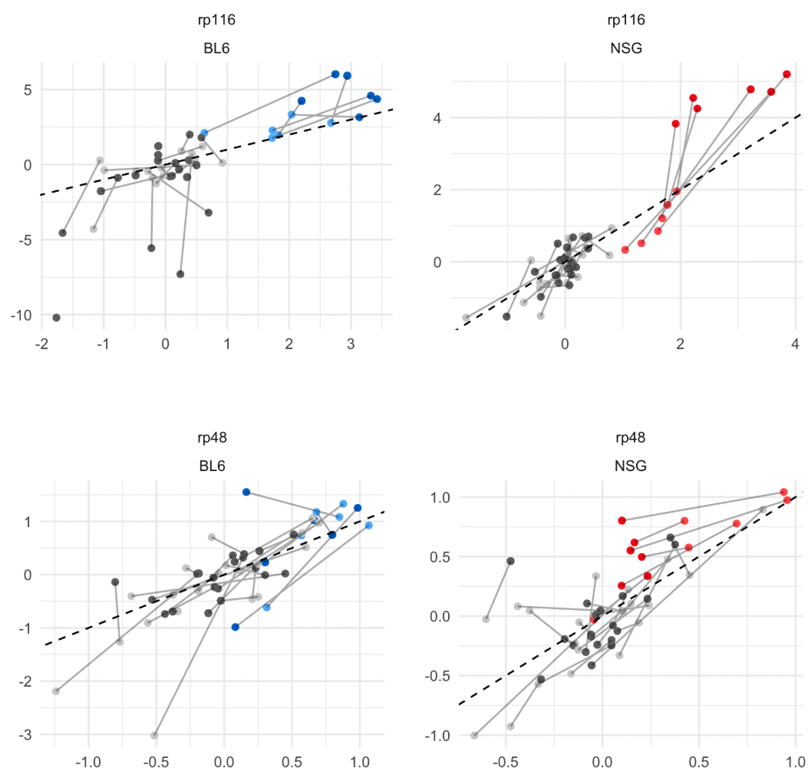
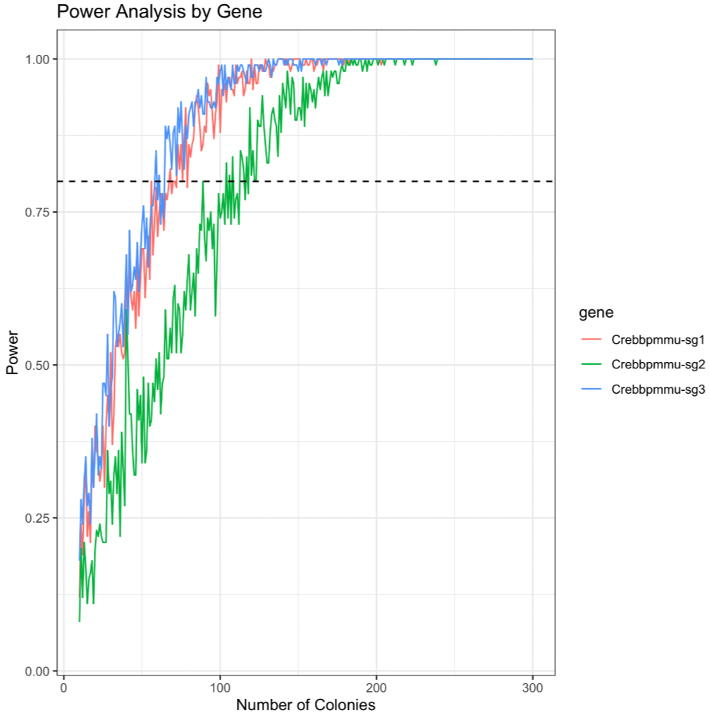
Moba500

Slide 22
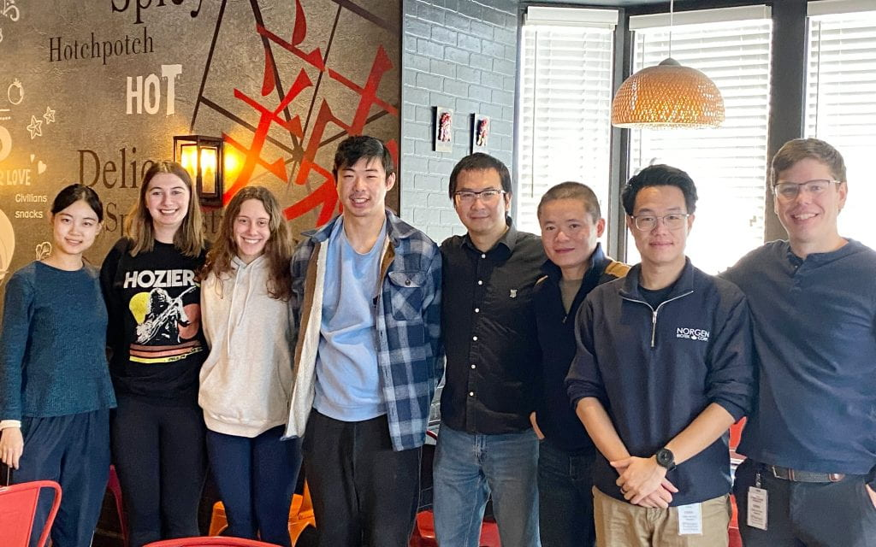
Thank You!
Questions?

